Slide 1
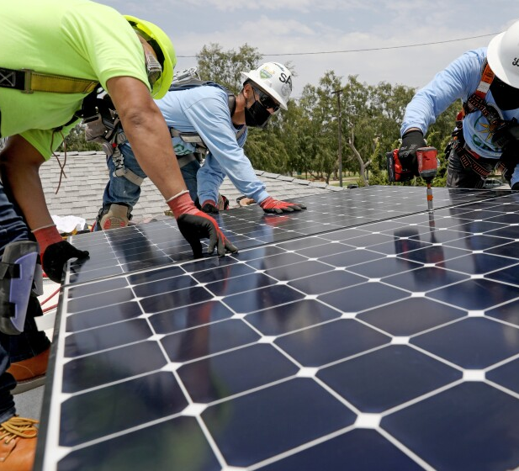
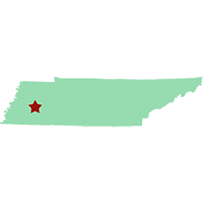






Mound City Solar
Jackson
Bringing Sustainable, Clean Energy to a Tennessee Disadvantaged Community

