Slide 1
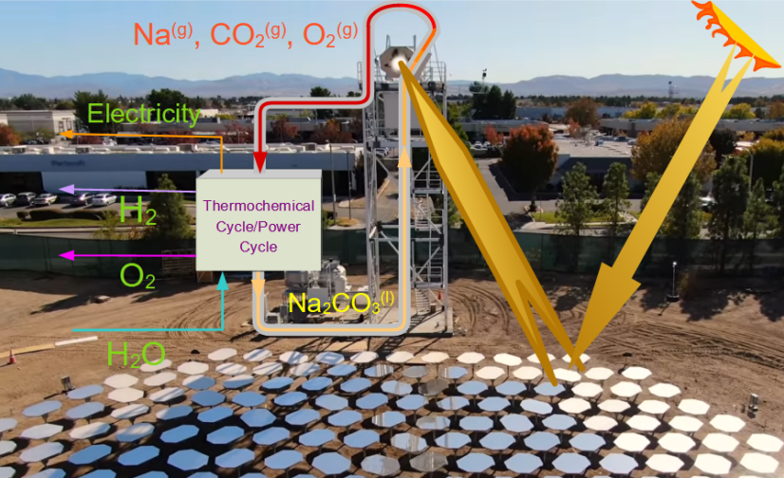
Team HERC
Mission:
Empower communities to better use local environmental resources in a sustainable manner
Provide grassroots, in-person engagement with the community
Bring consultation concerning green energy topics and climate change
  Local energy generation methods
  Wastewater management and treatment
  Job creation

