Slide 1
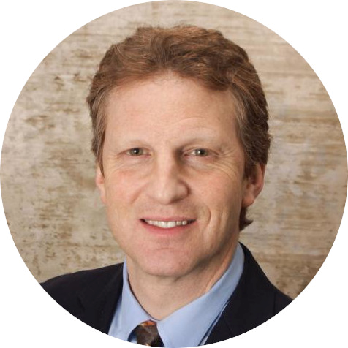

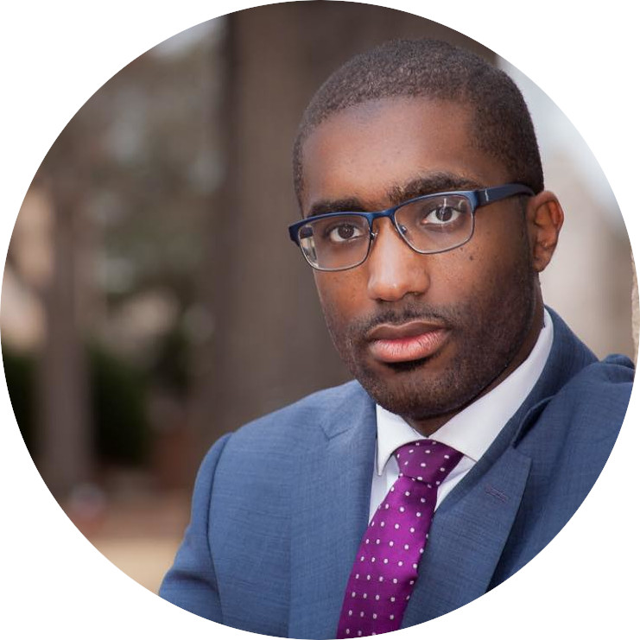

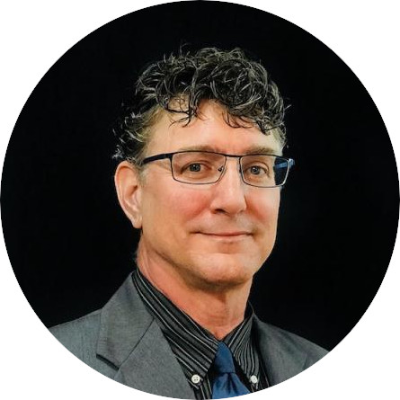
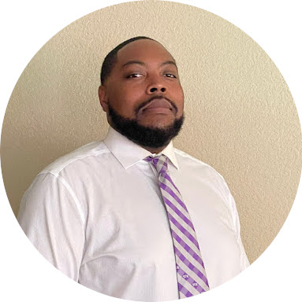
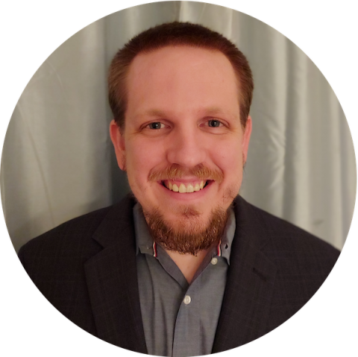
Bringing Advanced Demand Response Programs to Apartment residents
Brad Kayton COO
Sales and Outreach
Dr. Alex Papalexopoulos President and Market expert
ZOME is pioneering advanced frameworks to allow residents in multi-dwelling units, especially those in low income housing, to be a part of high value grid services that are normally only available to industrial users with automation that reduces interaction and minimizes impacts on tenants
Rev. Dominique Grate Diversity and Inclusion Director
Mayank Saxena CTO
ZOMECloud Architect
Sam Wynn SVP for Deployment and Outreach
Bobby Grant Analyst and Energy Trader
Aaron Thompkins Sales Engineer

