Slide 1

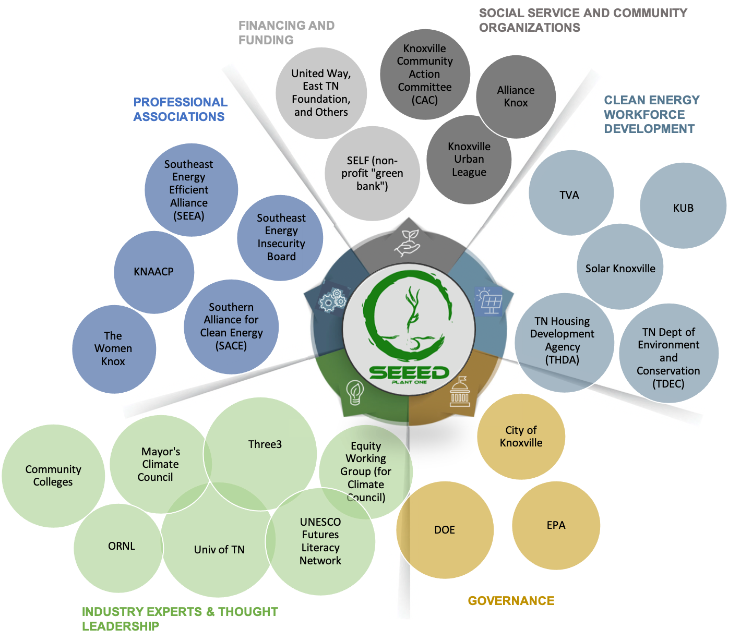

SEEEDing Knoxville’s Just Energy Ecosystem
Proposal submitted by
Socially Equal Energy Efficient Development (SEEED)
Knoxville, TN (Urban Appalachia)
Project Goals
Inspire and increase participation in clean energy jobs training and economic advancement for the disadvantaged young people in the under-resourced neighborhoods served by SEEED.
Enable the development of replicable clean energy transitions that deliver equitable benefits across disadvantaged communities.
Expand SEEED’s network through the development of new connections and strengthening existing partnerships to create a just energy ecosystem.
Advance futures literacy capabilities for the people whose current future includes capacity building for the clean energy economy and those on the frontlines of climate change.

Slide 2
Knoxville Tennessee
Urban Appalachia
SEEED’s energy Innovation project has two objectives:
To inspire and increase participation in clean energy jobs training and economic advancement for the disadvantaged young people in the under-resourced neighborhoods served by SEEED.
To enable the development of replicable clean energy transitions that deliver equitable benefits across disadvantaged communities.
Embedded in the struggle are barriers stemming from racial wealth disparities as well as a lack of futures literacy necessary for decision-making at the community level. Low income residents just don't understand how they will bear the brunt of climate change or how they can benefit from the green economy. Through this challenge, partners would connect with local and global institutions to bridge knowledge and build capacity to advance economic opportunity and plan for a more inclusive and clean energy future.

