Slide 1
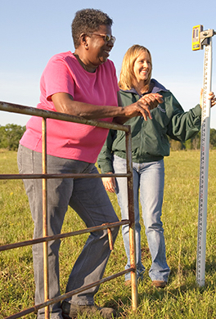
Bison Underground & the Inclusive Energy Innovation Prize
Mission: Address intersectional climate, agriculture, and social issues
Technology: Mitigate climate change through sequestering carbon in agricultural soils, which produces environmental, agricultural, social, and economic benefits
Values: Build and strengthen relationships; Foster connections between people and organizations from across the social network in Oklahoma; Serve everyone with an emphasis on dignity, transparency, and optimism
Objective 1: Build the technical capacity of farmers, potential farmers, and other agricultural leaders to use cutting-edge carbon sequestration and soil health techniques and tools
Objective 2: Increase awareness of and access to new tools and techniques to mitigate the impacts of climate change
Objective 3: Provide economic opportunities for low-income individuals, racial and ethnic minorities, previously incarcerated individuals, and people who have lost jobs through the energy transition

