Slide 1
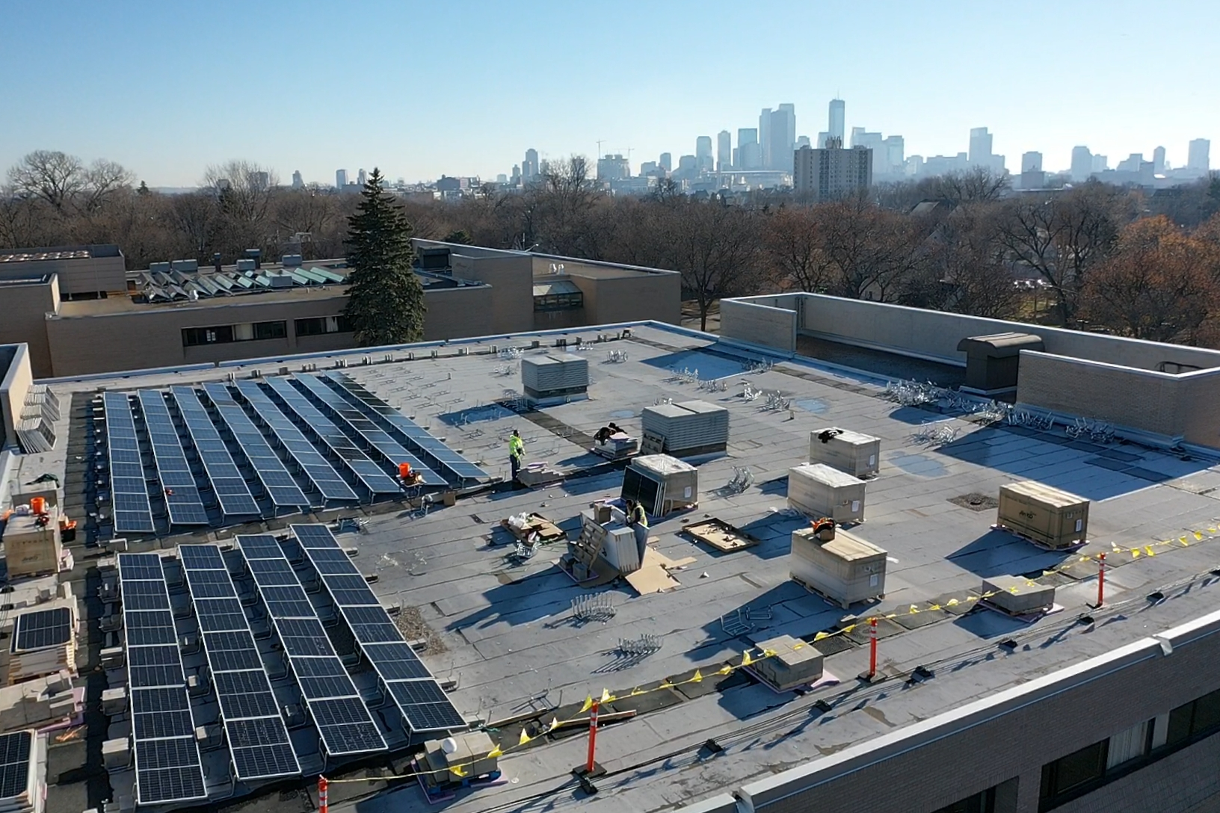

Renewable Energy Partners
A certified MBE solar energy developer that champions projects with social benefits
Skills training in emerging clean energy and climate action
Focused recruitment on BIPOC youth and young adults
Solar resiliency hubs and community-owned solar gardens
Innovative energy projects in Environmental Justice neighborhoods
STEM learning activities focused on clean energy and climate
Building awareness of opportunities among BIPOC youth
Sustained community engagement
Energy Experience Centers and grassroots organizing
Strategic partnerships with MBEs to build development capacity

