Slide 1
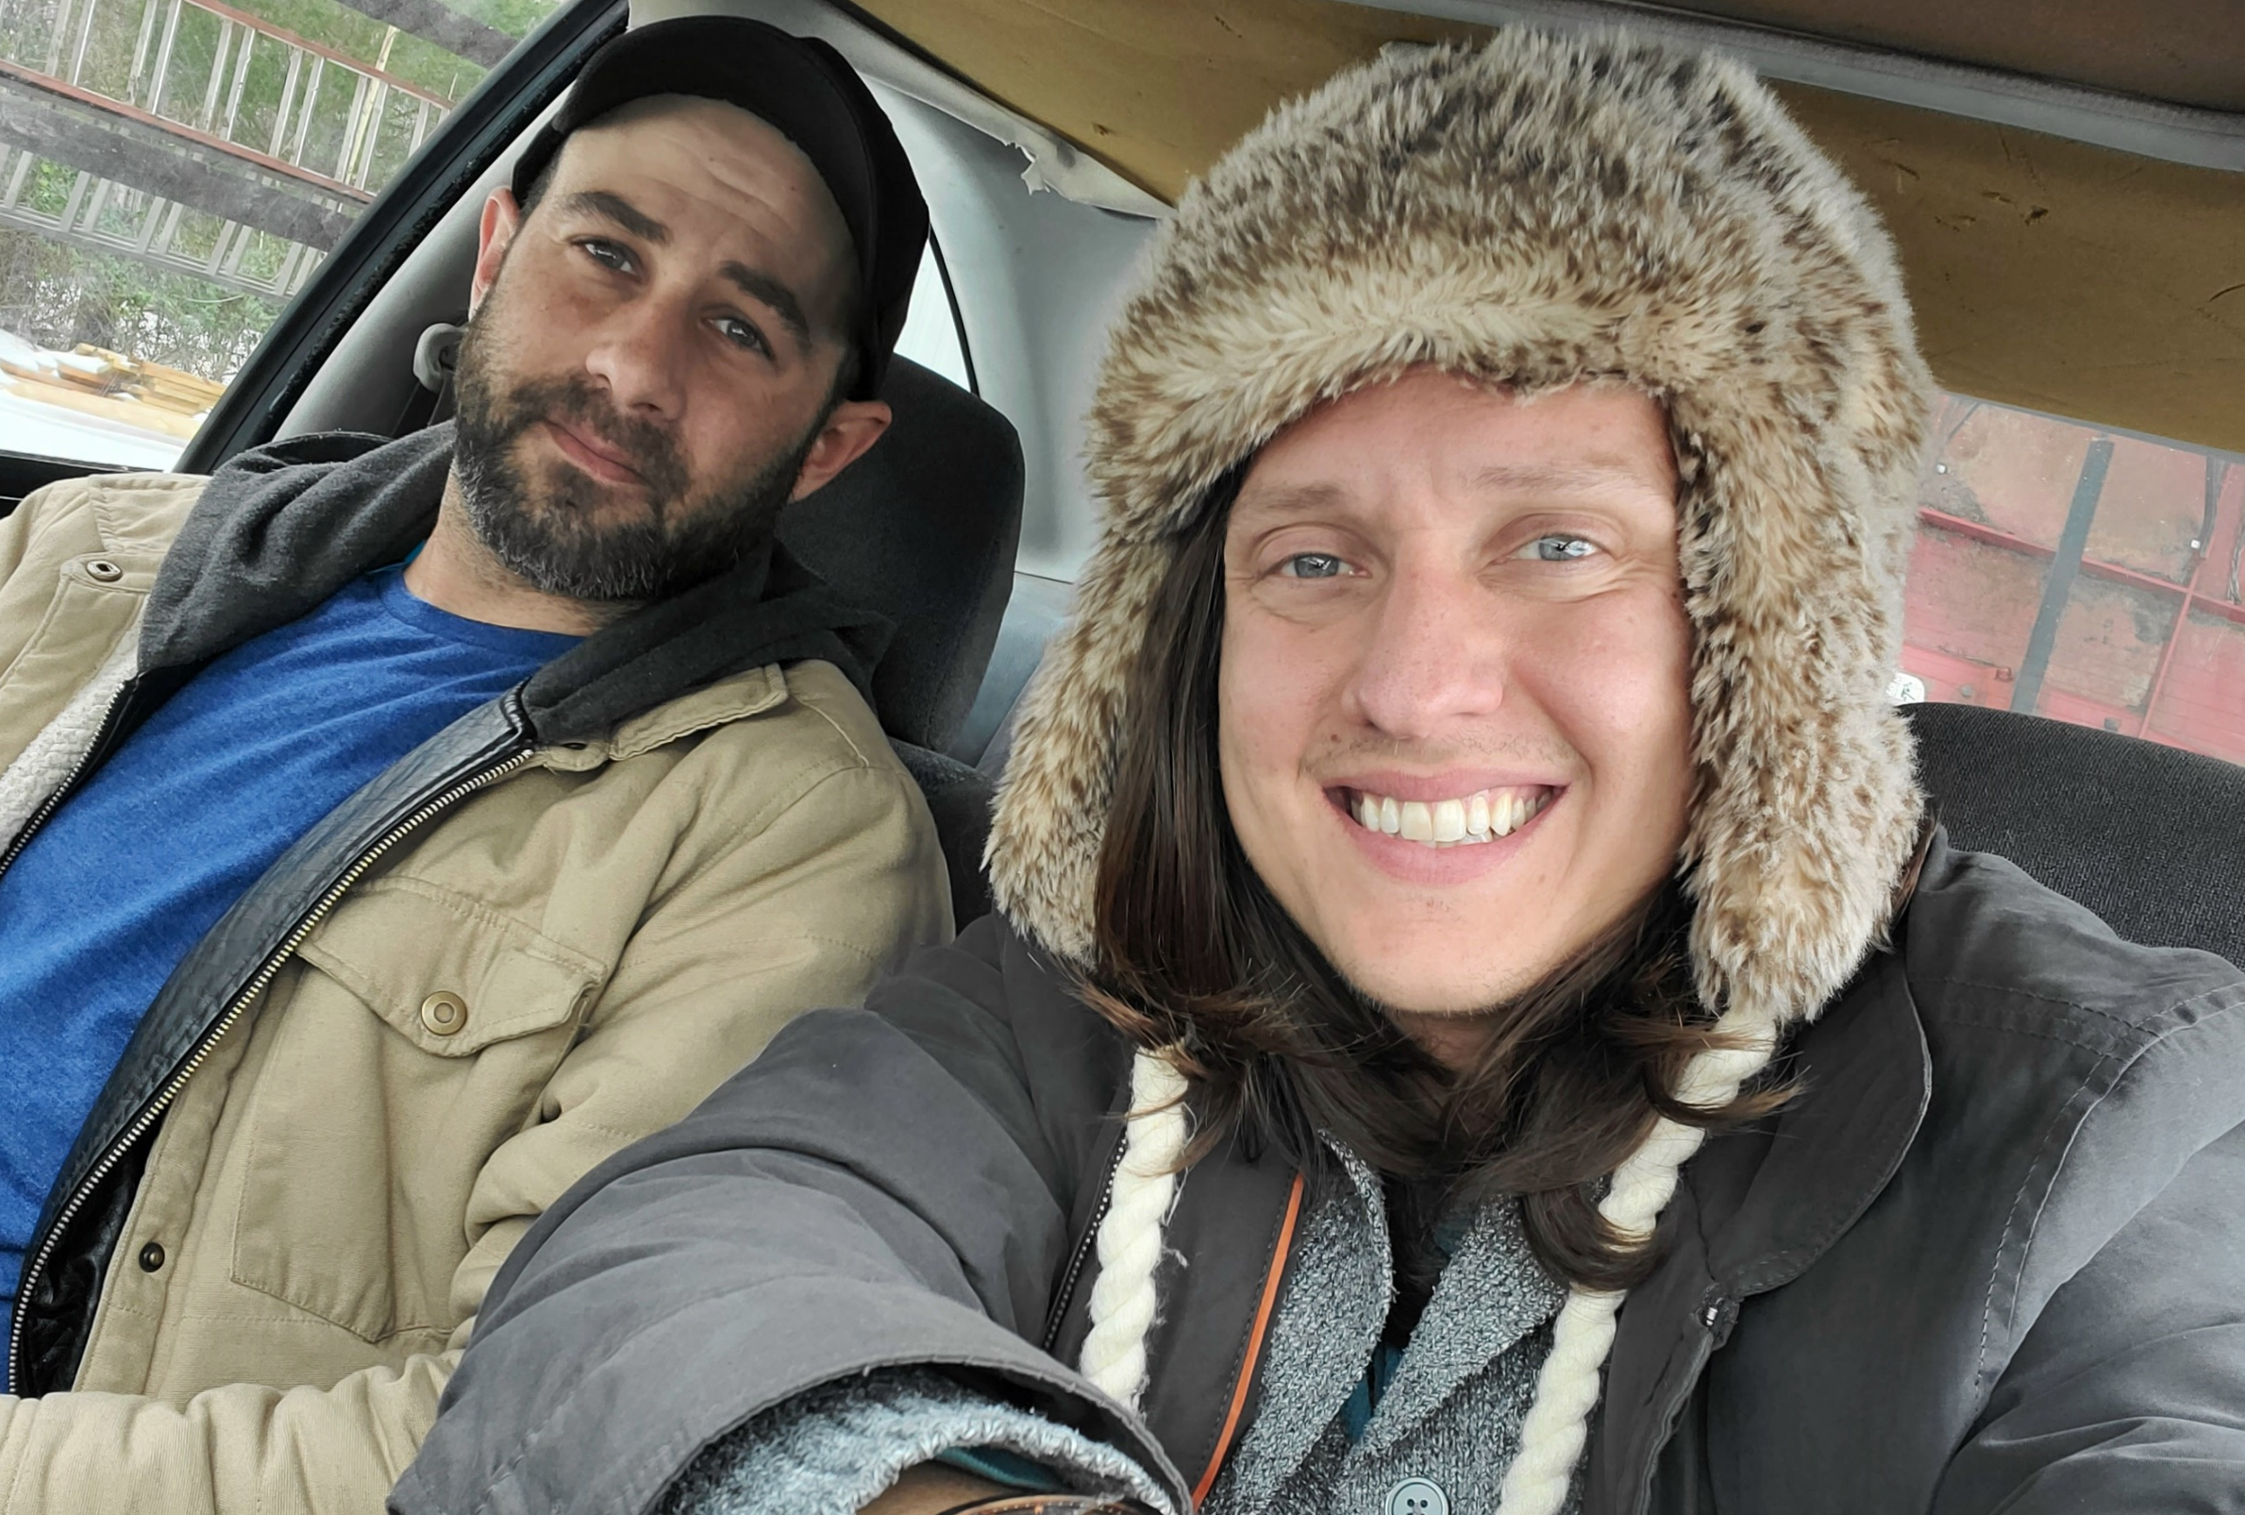

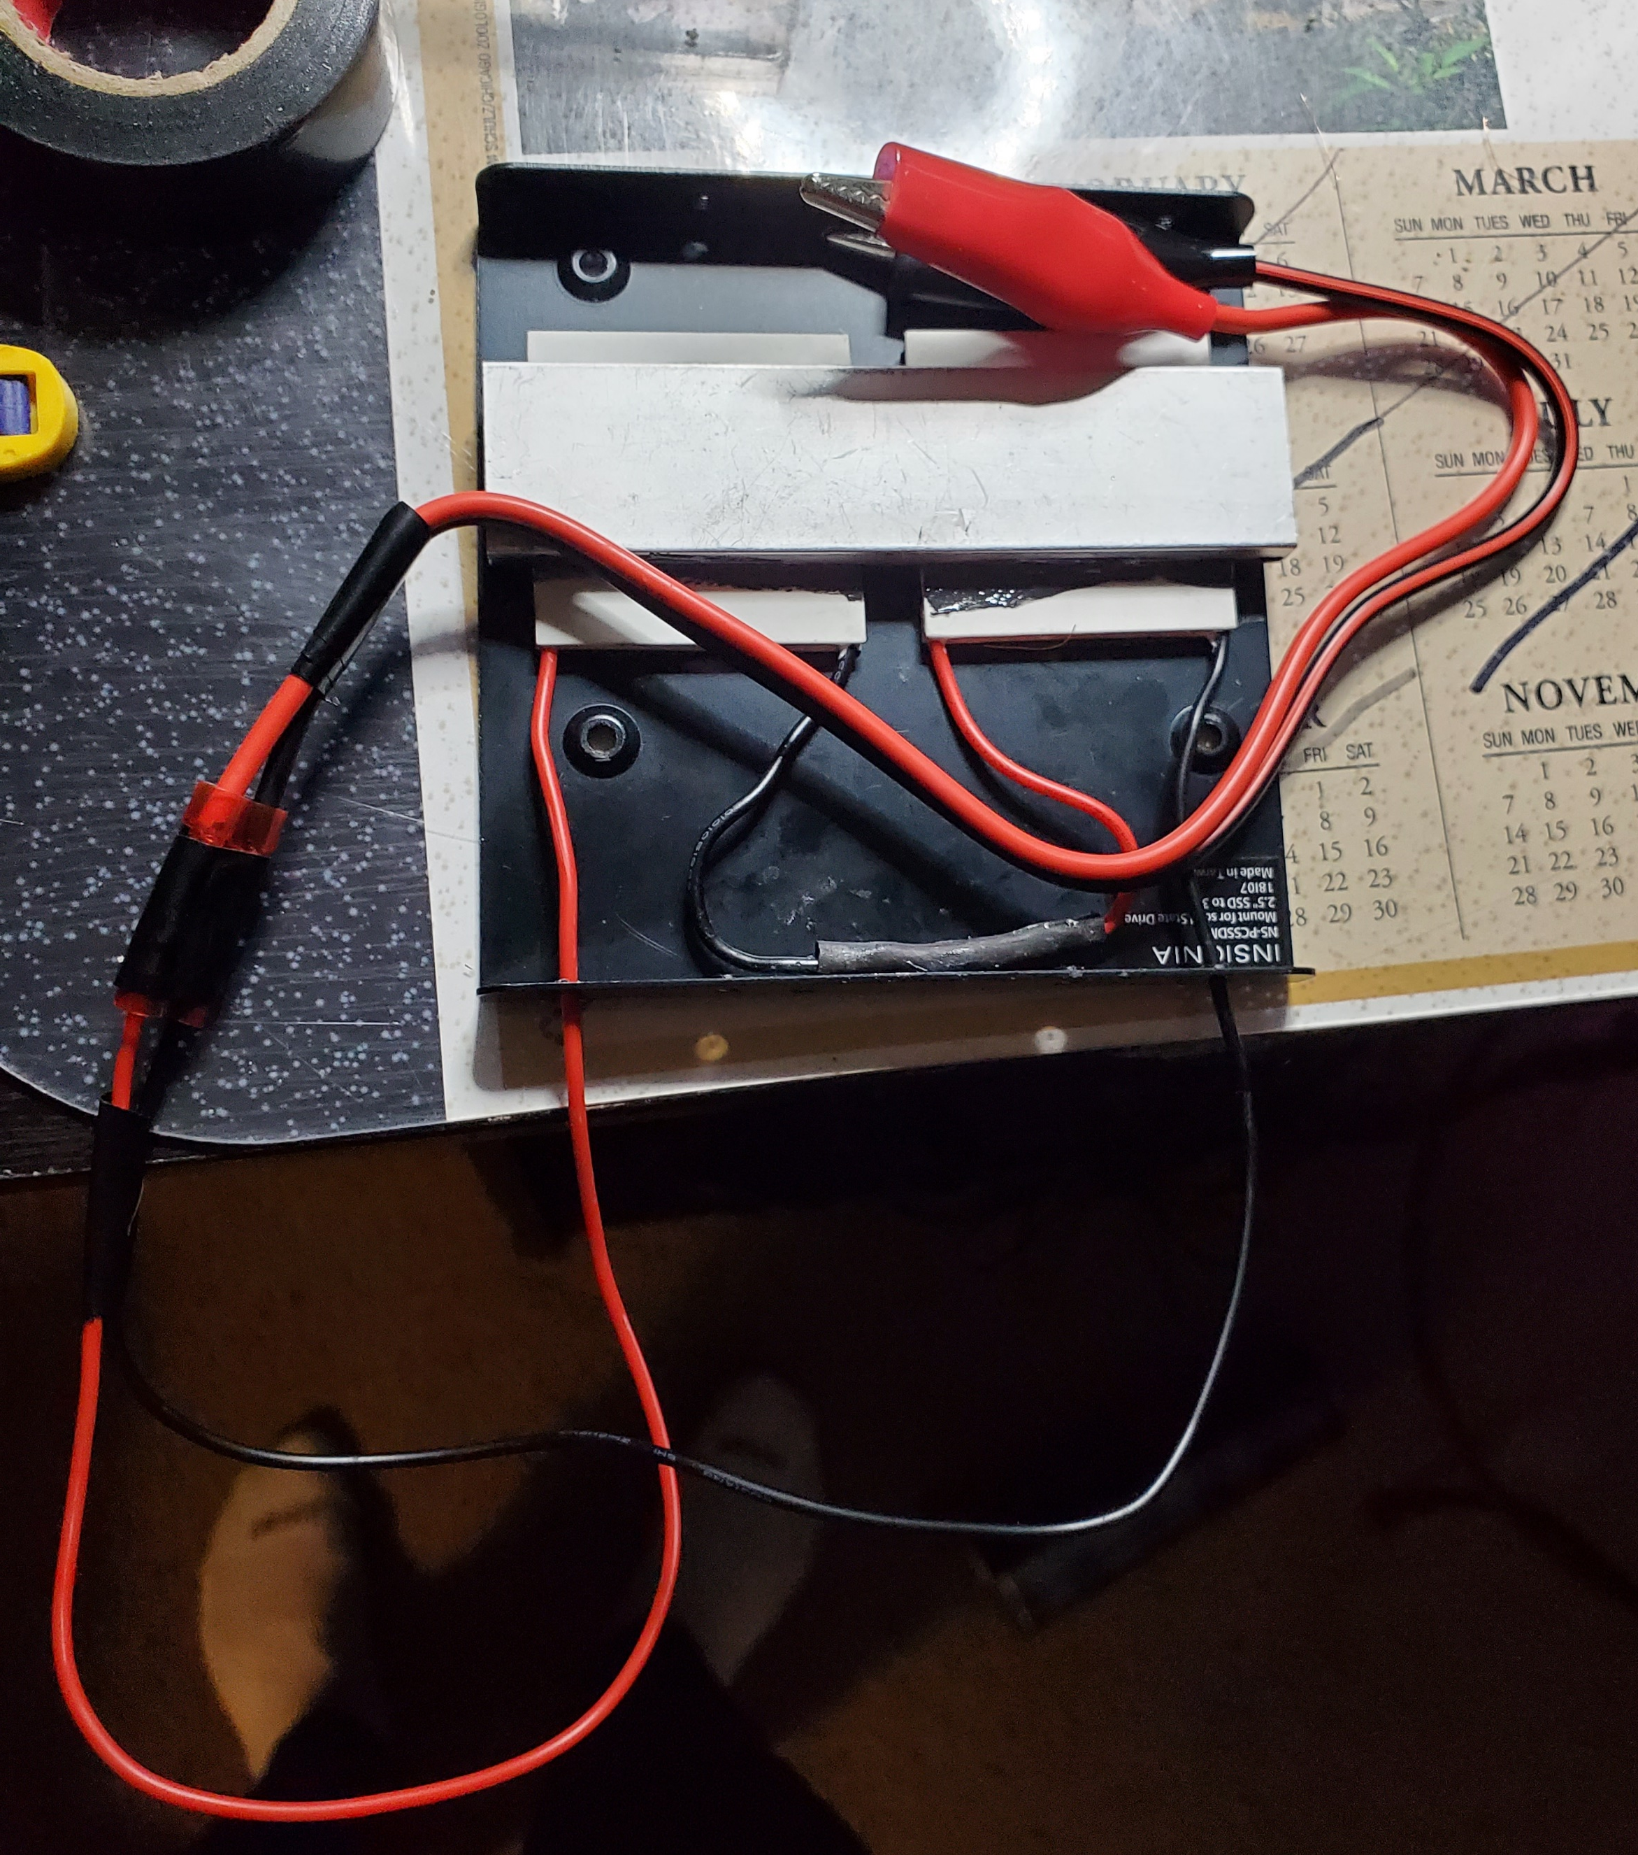
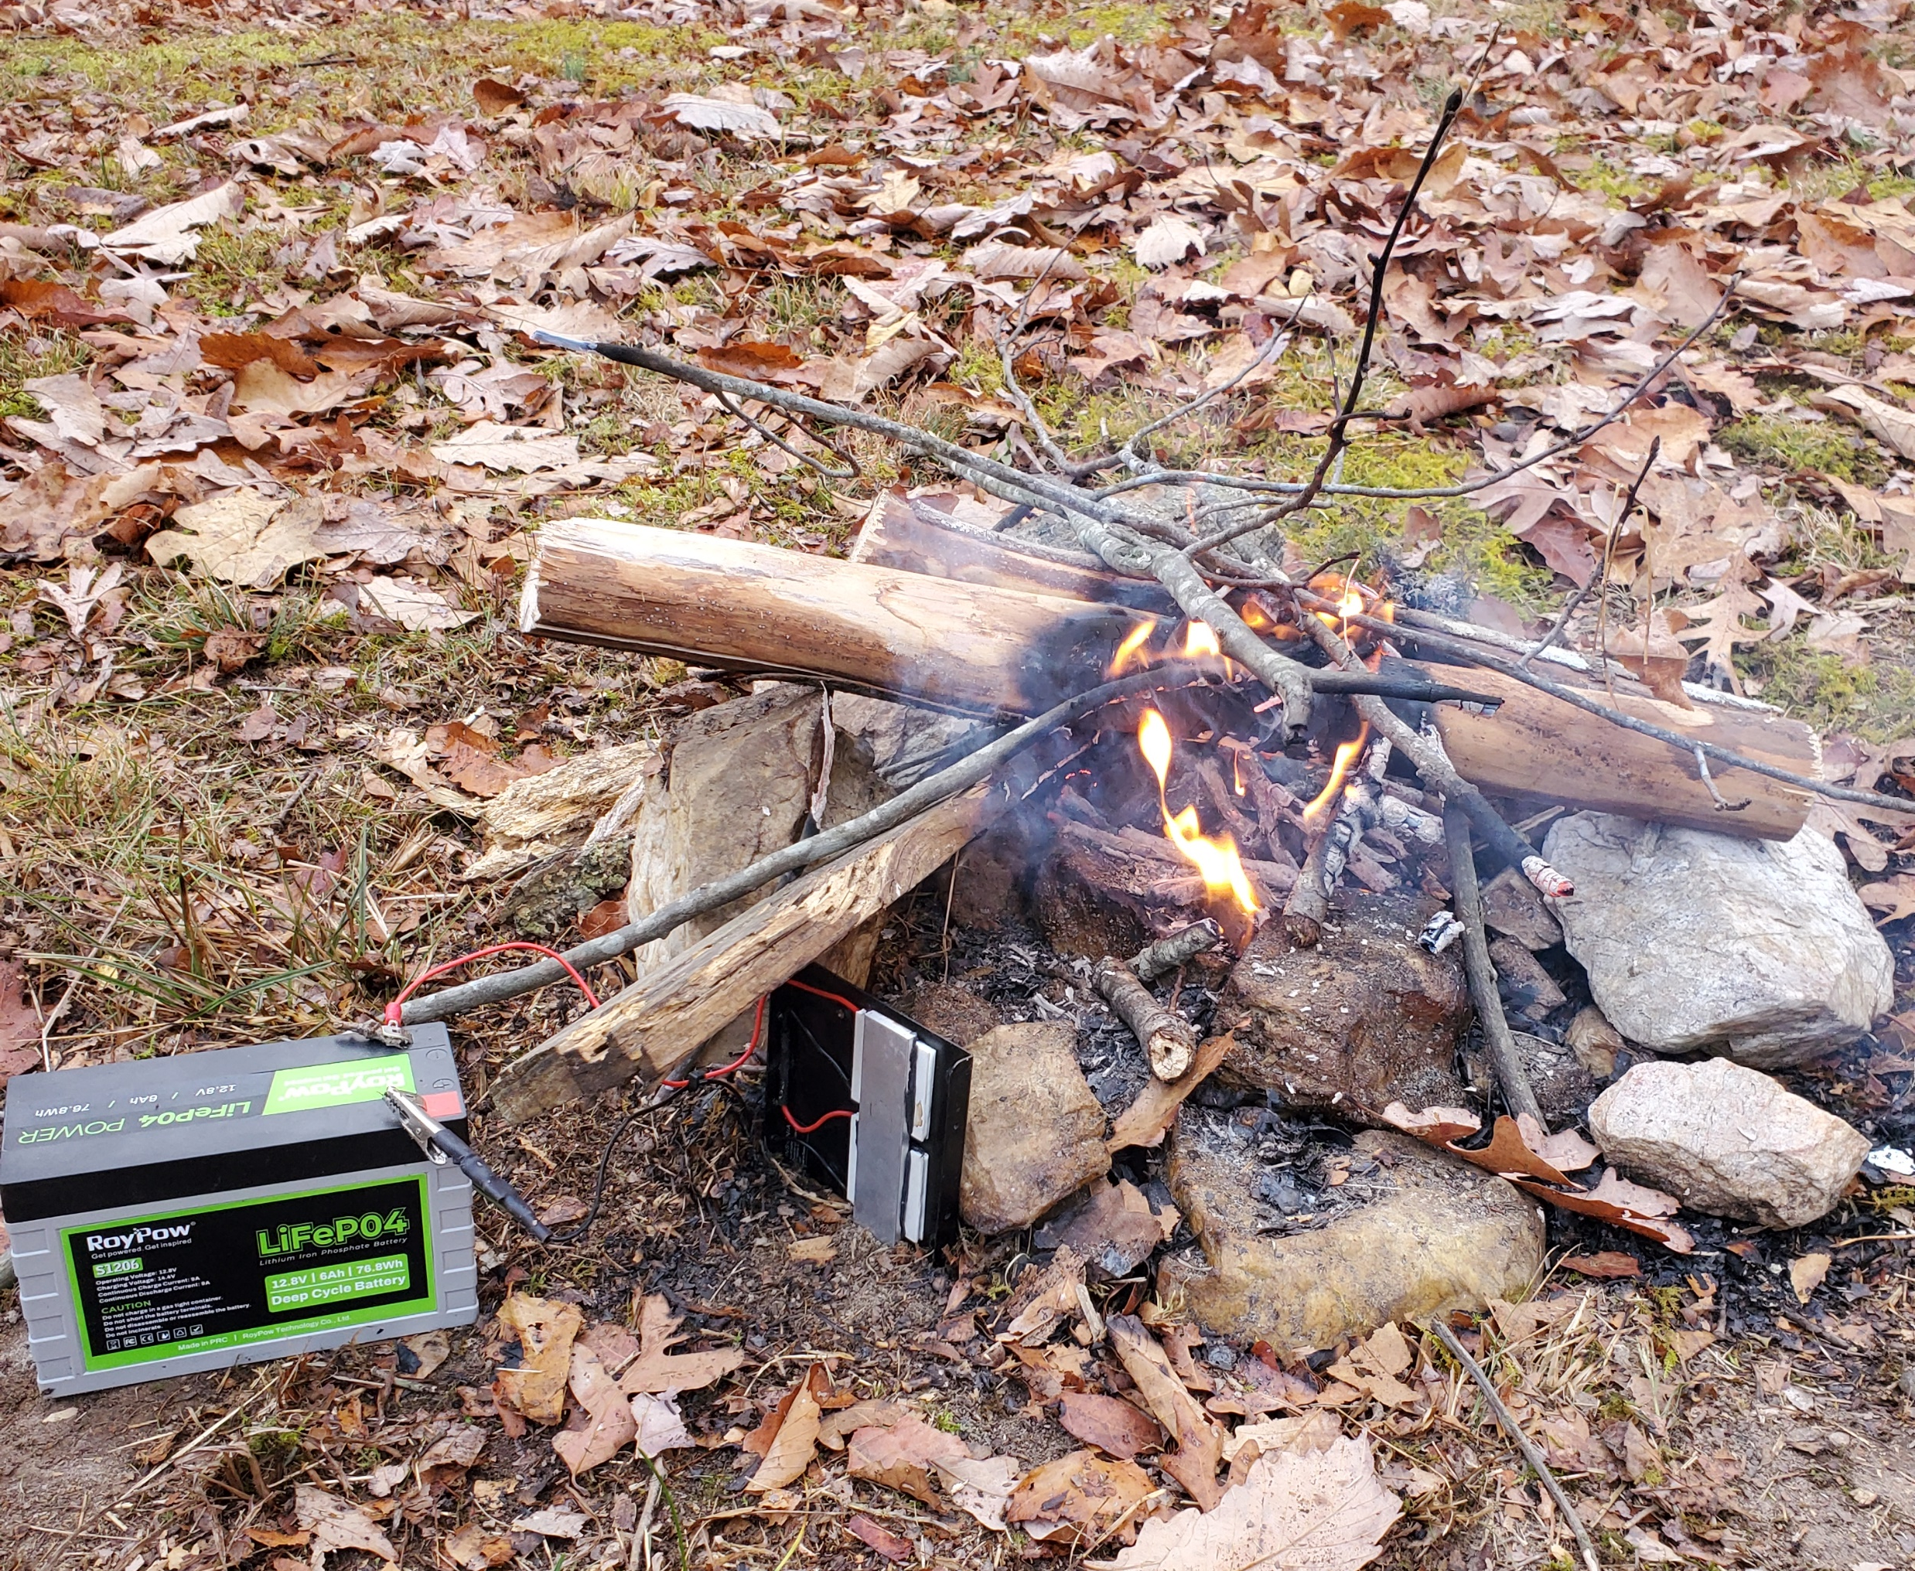
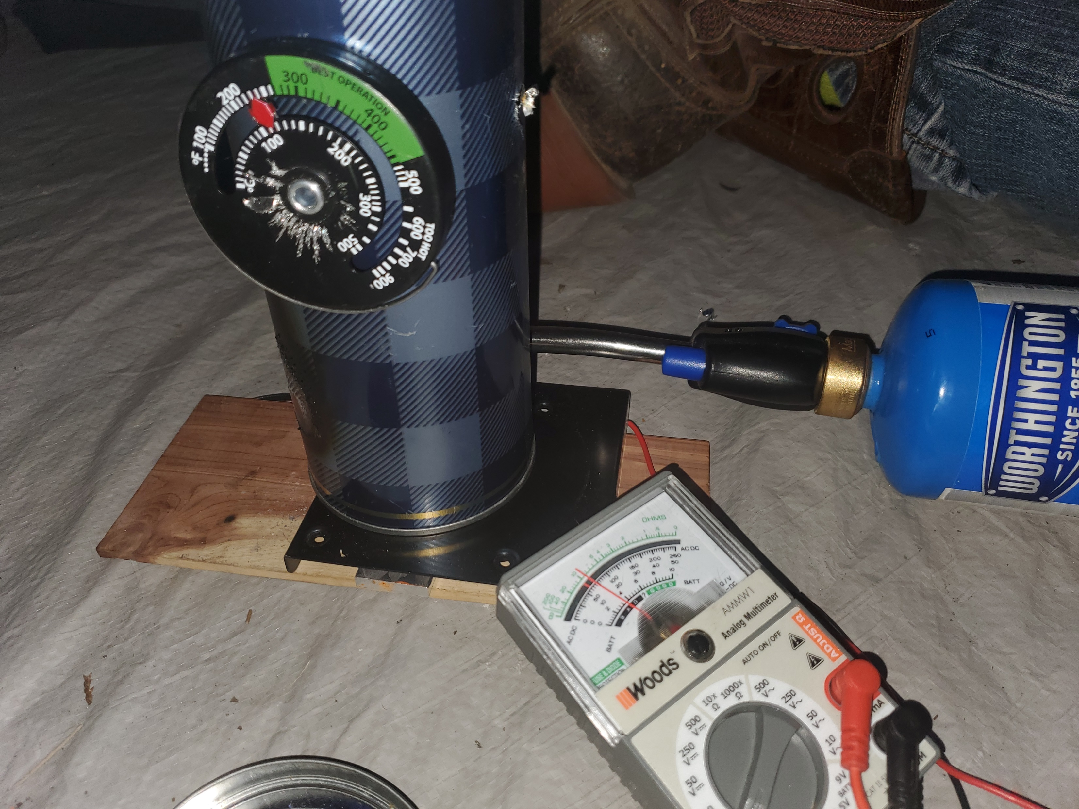
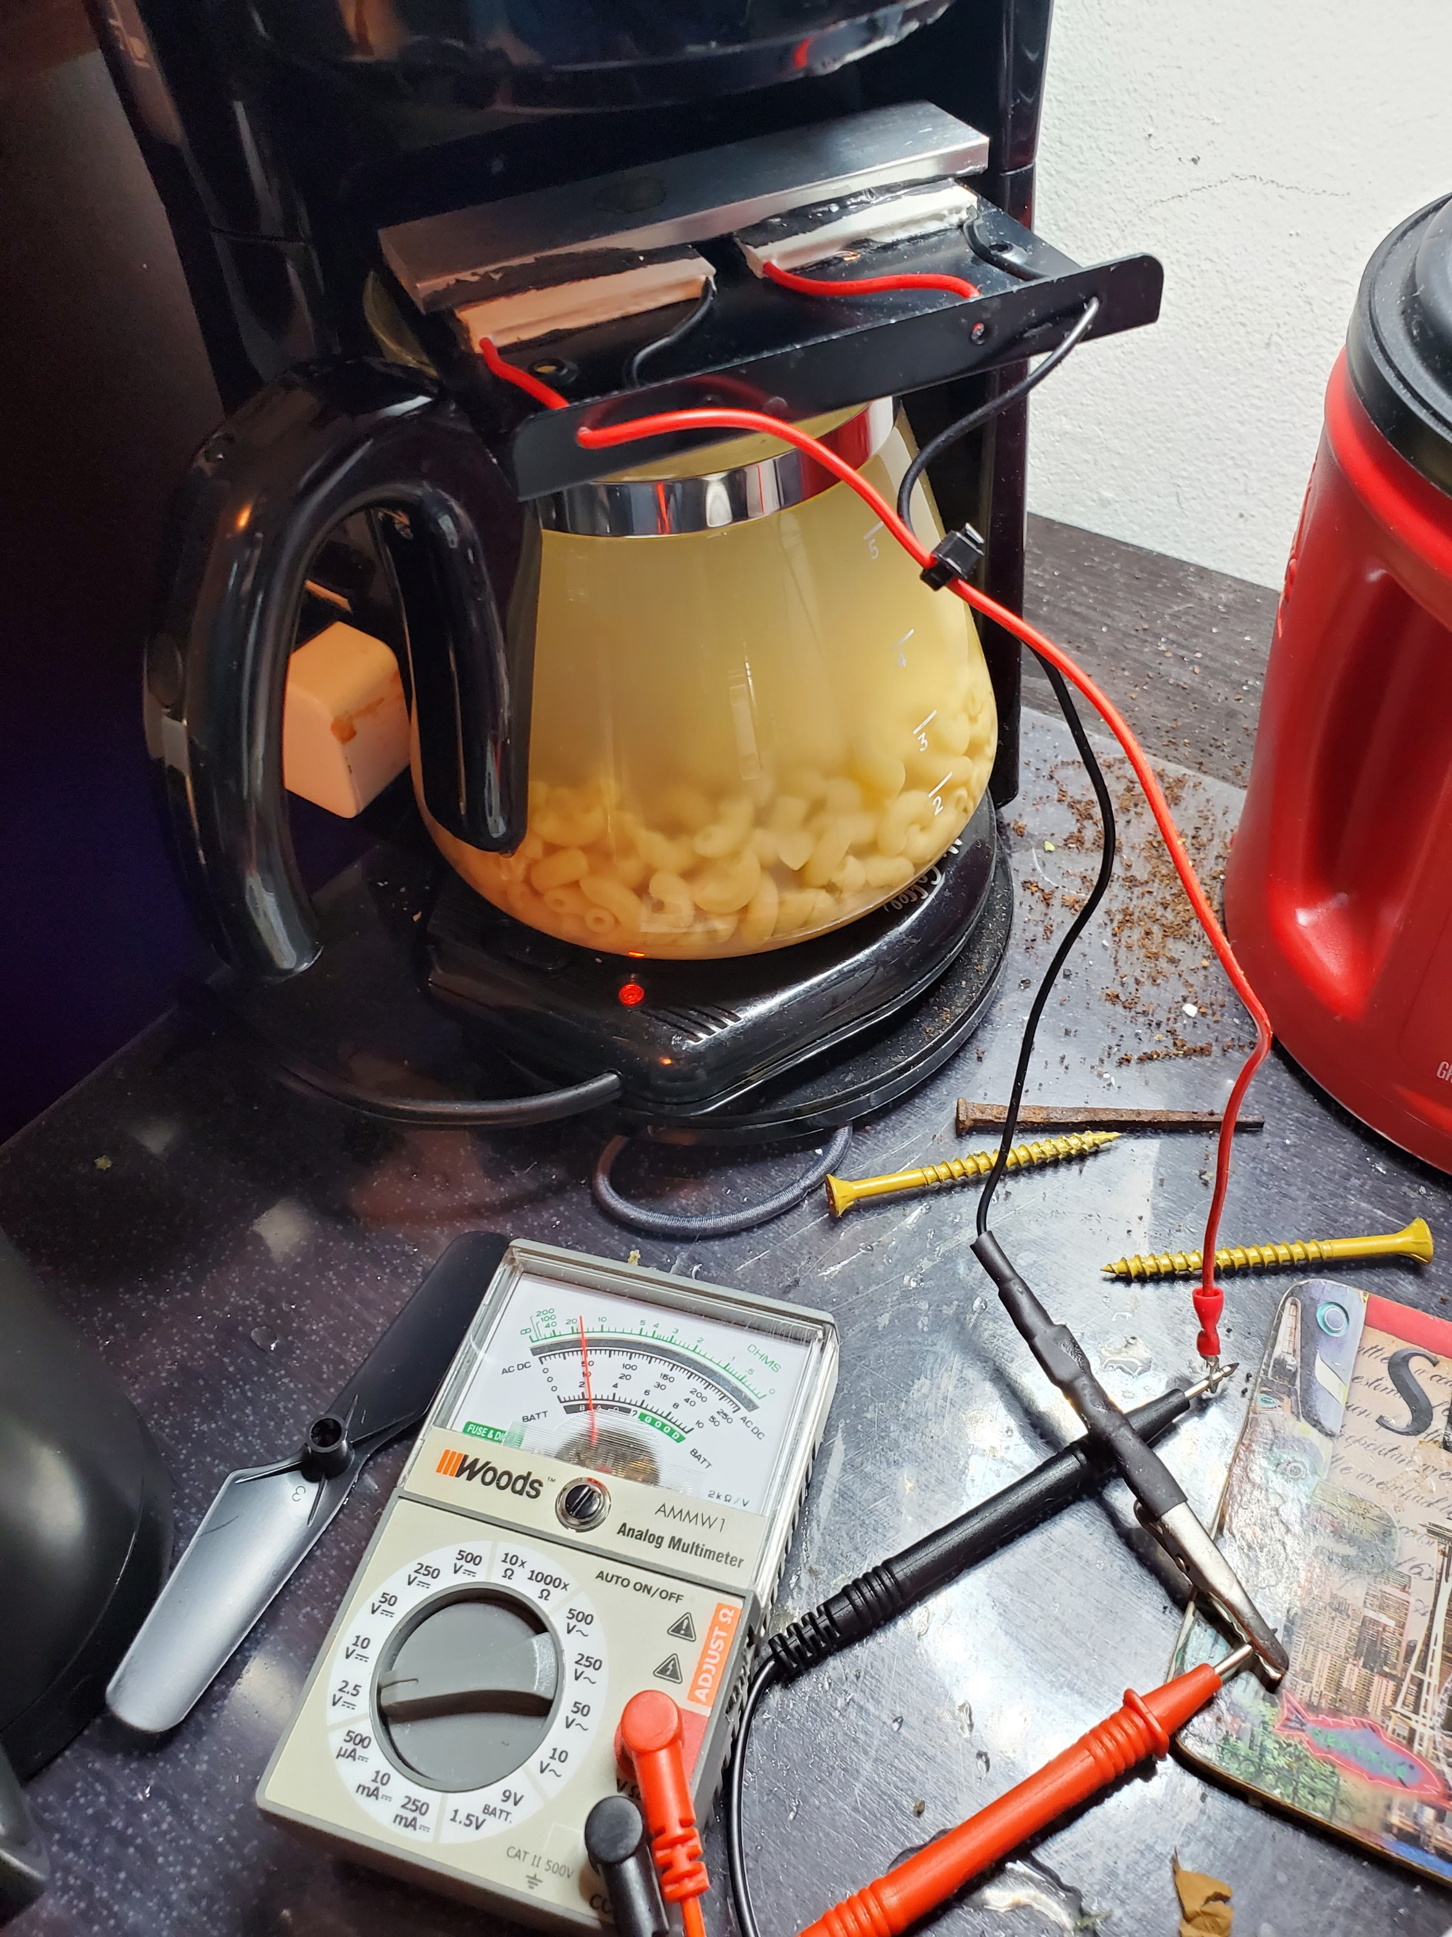
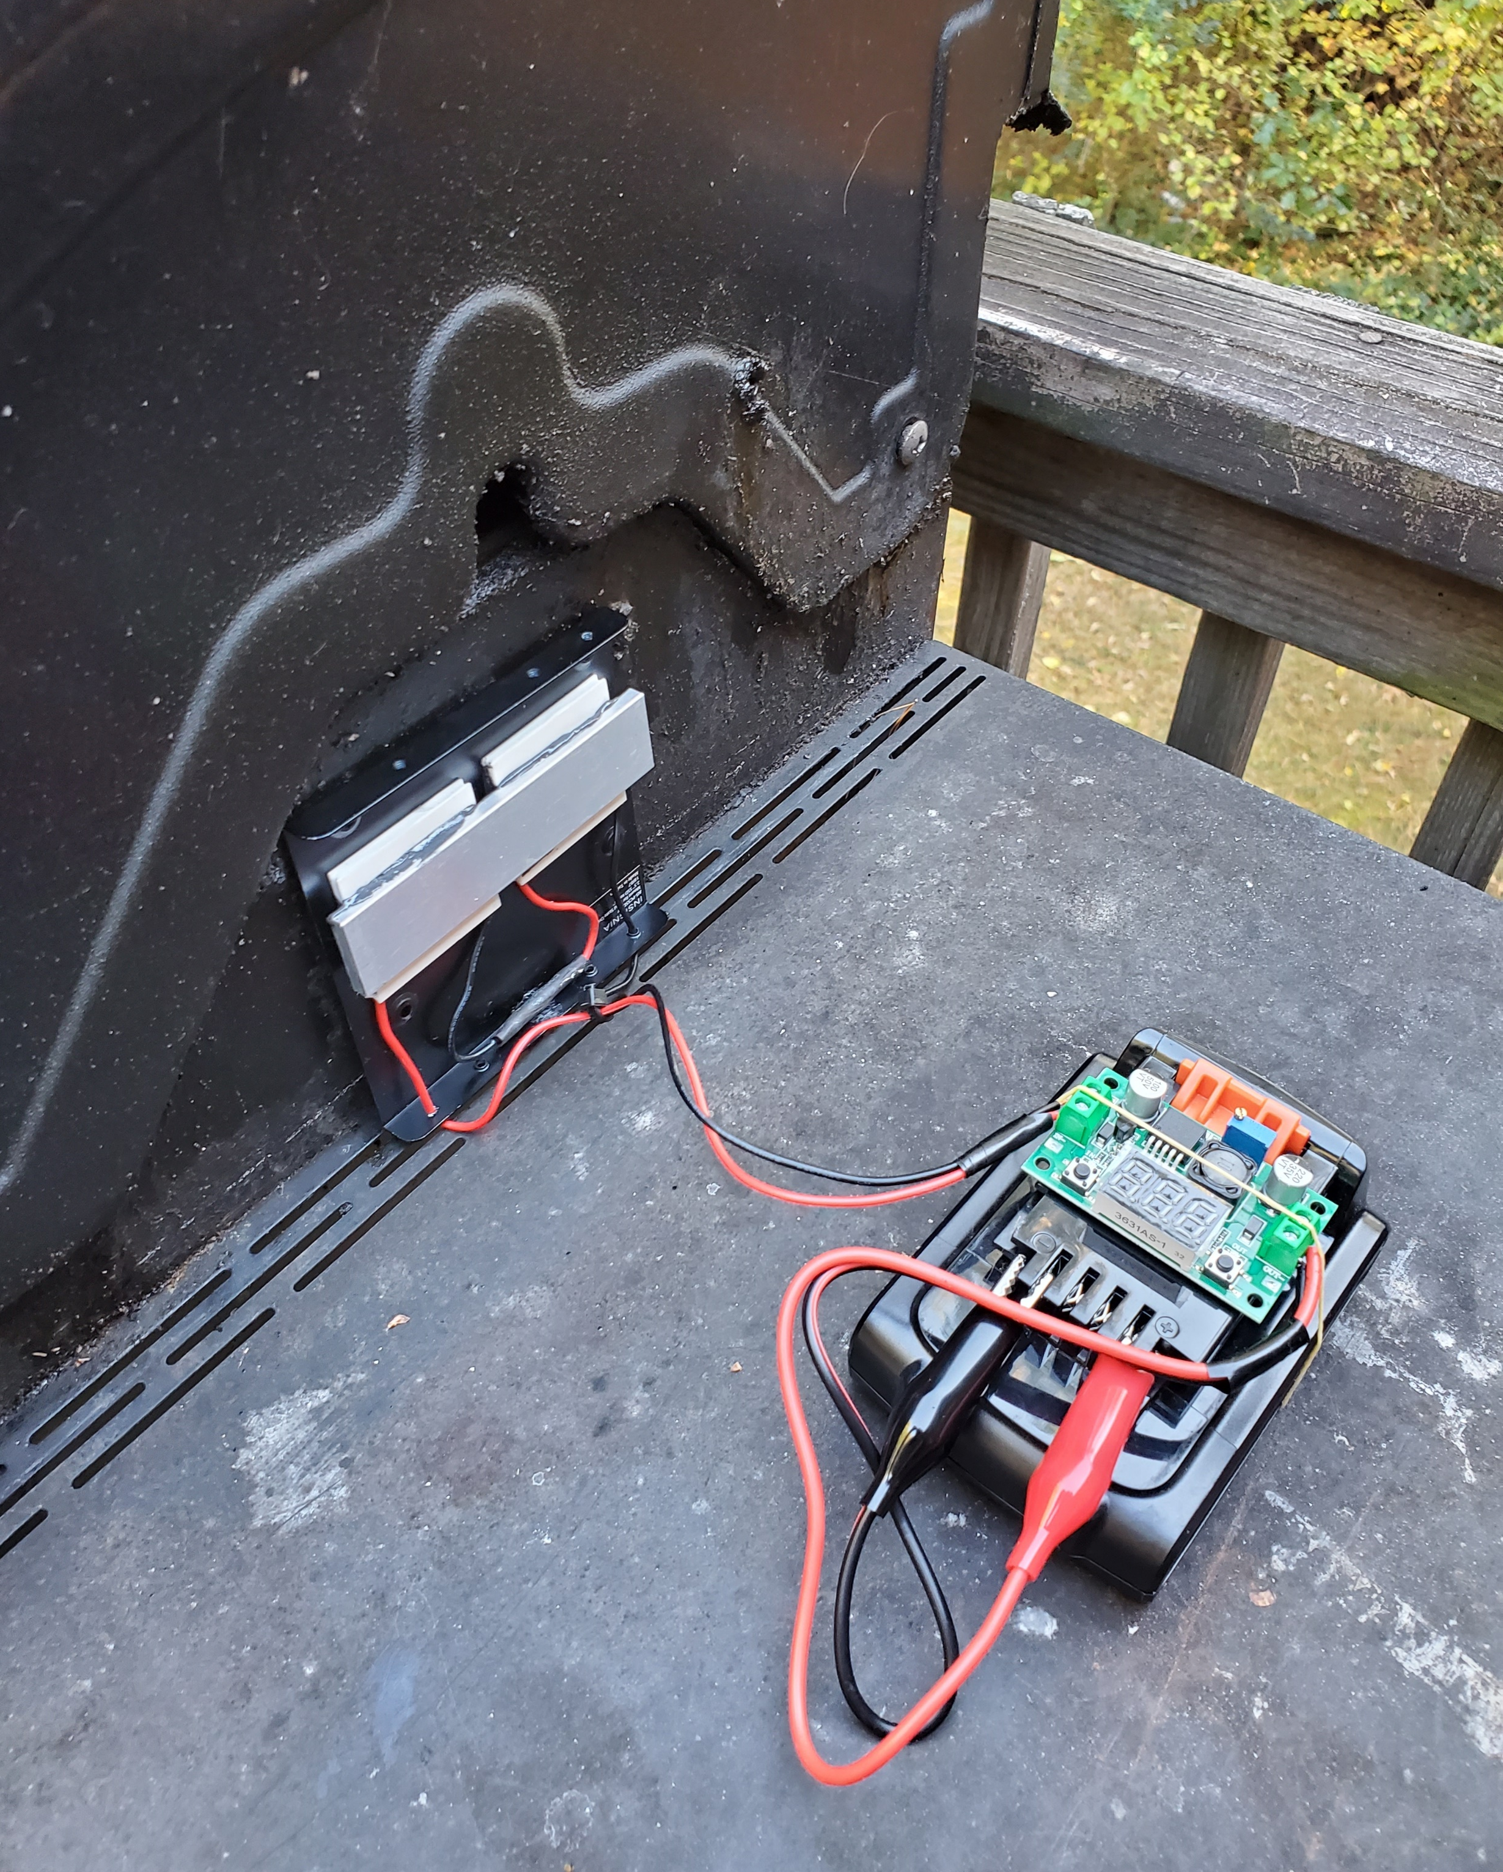
Mission
To promote grassroot Energy Independence solutions to Native American, Alaskan Native Tribes and Service-Disabled Veterans
Team
Colby C. Burnam
Michael J. Gregg
Atlas TEG V1.0

