Slide 1

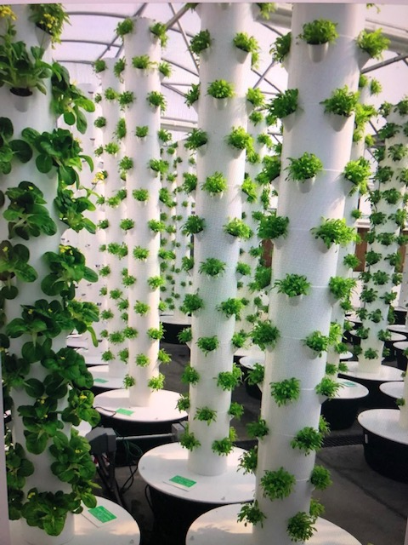

Liquid Kind
Aeroponics

