Slide 1
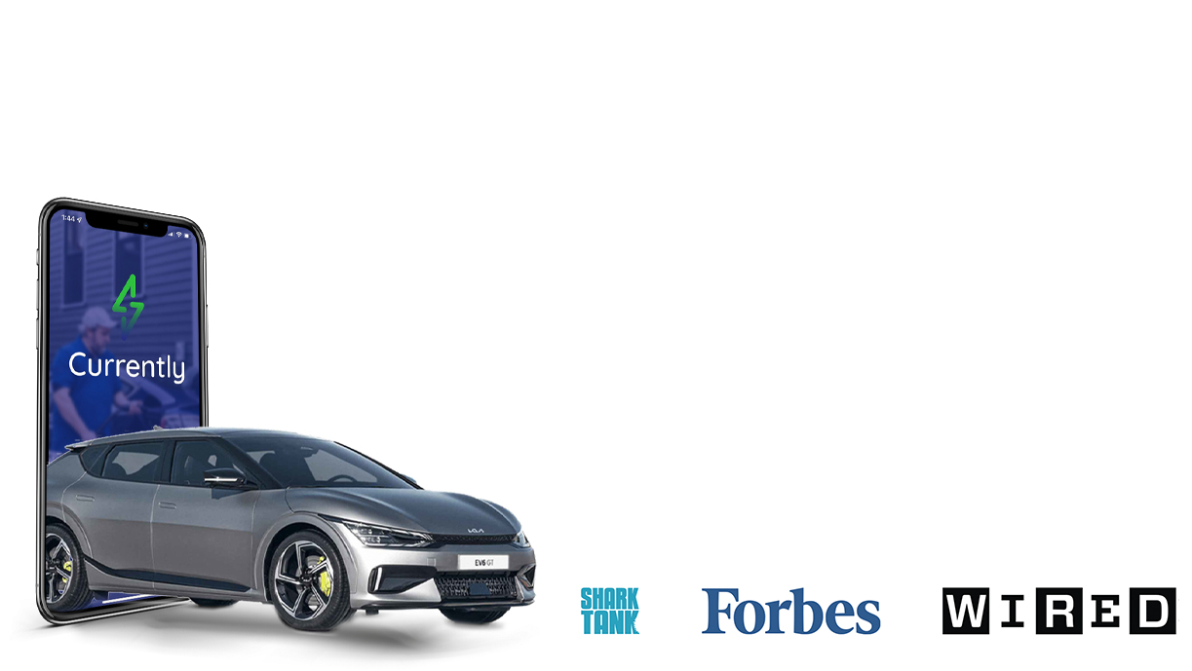

Making EV ownership easy by partnering with businesses to create the world’s first mobile and intelligent on-demand EV charging network
As seen on…

