Slide 1
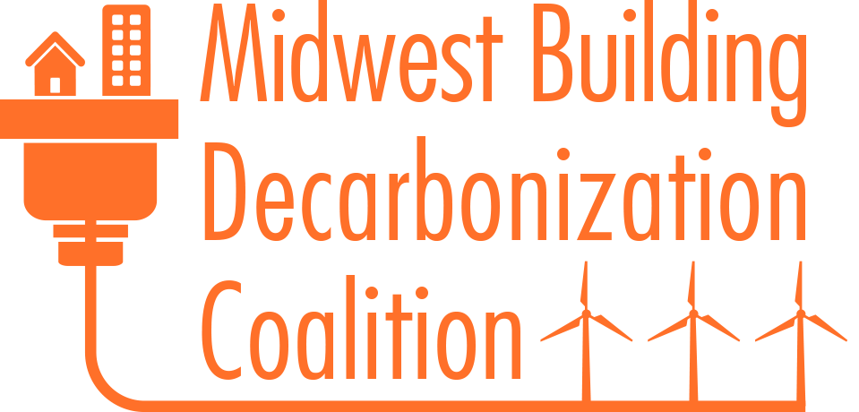
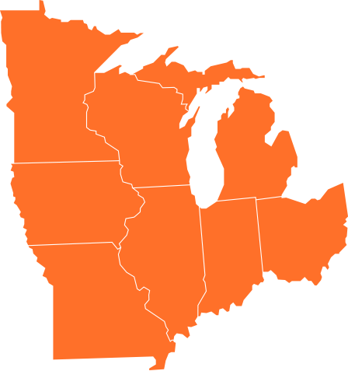


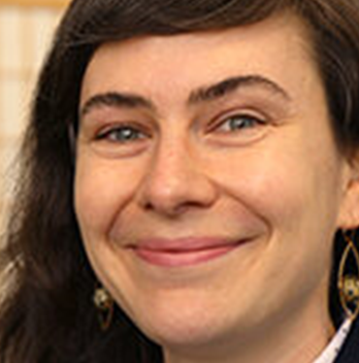
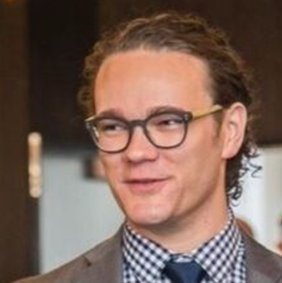
Overview: To develop and implement equitable strategies to achieve zero emissions from the Midwestern building sector by 2050. We identify eight states in our coalition footprint: Minnesota, Iowa, Missouri, Wisconsin, Illinois, Indiana, Michigan, and Ohio. The coalition provides resources and support for the building decarbonization work of engaged local organizations.
Prize Goals: Midwest Building Decarbonization Coalition seeks to expand our technical, financial, and training assistance to decarbonization projects by grassroots coalition members.
Marnese Jackson
Pontiac, Michigan
Jacob Serfling
Des Moines, Iowa
Margaret Cherne-Hendrick
Minneapolis, Minnesota
Eric Fowler
Saint Paul, Minnesota
midwestdecarb.org
Notes:
Jacob
Mission: To inspire and educate Midwesterners to end new installations of fossil fuel equipment in residential and commercial buildings by 2030, and to achieve zero emissions from these buildings by 2050, with intentional and consistent integration of equity and labor justice across all facets of our work.

