Slide 1

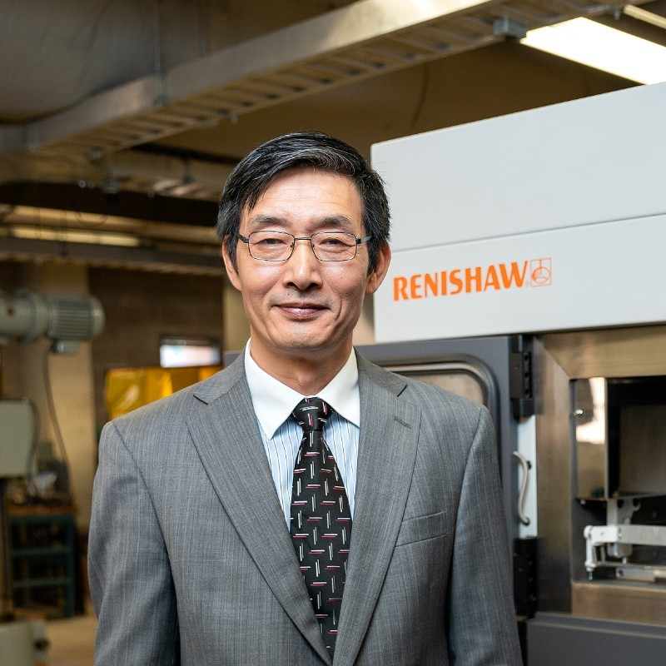

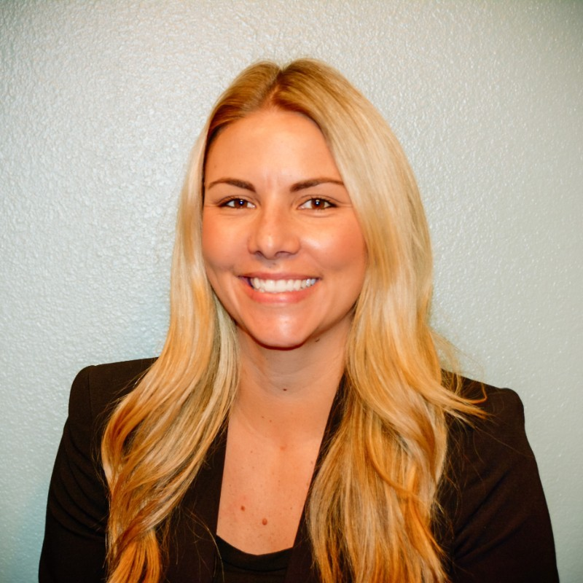

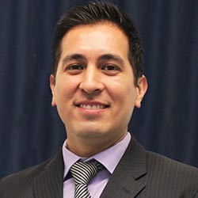
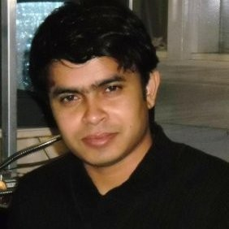
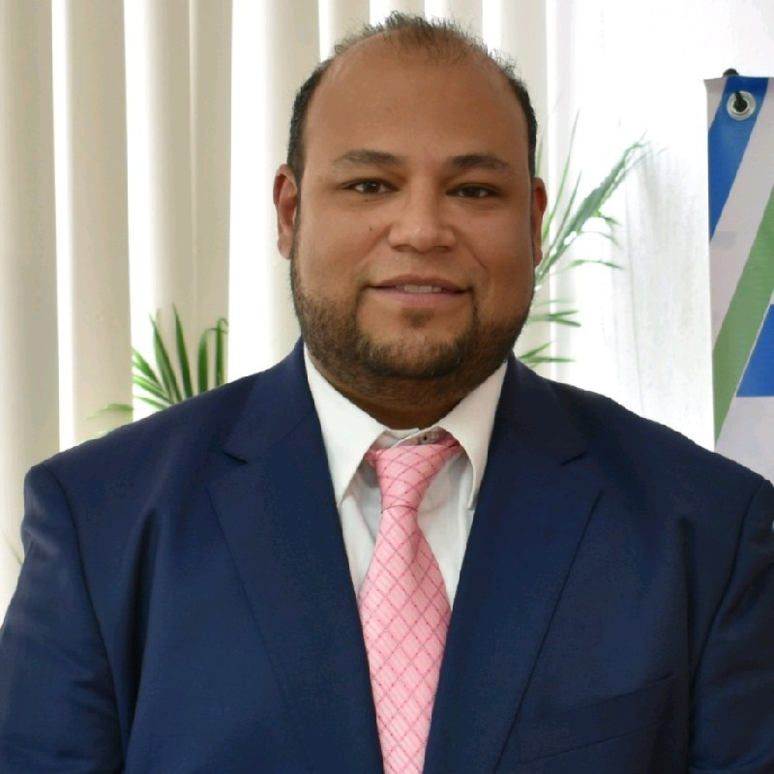





Solar Utilization and Commercialization Coalition for Energy Efficiency Devices (SUCCEED): A Pipeline to Support Solar Energy Innovation and Manufacturing in Texas/Mexico Border Region
The US Mexico Foundation for Science (USMFS) has a diverse portfolio of projects with the shared goal of promoting social and economic development in those regions where it operates through education, entrepreneurial support and business development. Today, USMFS focuses its binational efforts in the U.S.-Mexico border region. USMFS’s mission is to transform this region into the most inclusive, competitive and sustainable in the world.
Primary Recipient: US Mexico Foundation for Science (USMFS)
Linda Ufland,
Director, Entrepreneurship and Commercialization Center (ECC).
Dr. James Li,
Ph.D. President Endowed Professor, Director, UTRGV Center for Advanced Manufacturing Innovation and Cyber Systems, Director, DOE Consortium for Additive Manufacturing for Energy Related Systems.
Project Director:
Jessica Lillie,
Executive Director,
USMFS
Team
Poised to be the second largest Hispanic-serving institution in the nation, the University of Texas Rio Grande Valley (UTRGV) emphasizes educating 21st-century leaders and professionals who are culturally fluent and have a deep understanding of the perspectives, languages and values of people from different backgrounds.
Laurie Simmons,
Director, Center for Innovation and Commercialization (CIC)
David Ortiz,
Director, Texas Manufacturing Assistance Center (TMAC)
Dr. Farid Ahmed,
Ph.D. Professor of Manufacturing and Industrial Engineering
Eugenio Marin,
CEO, USMFS

