Slide 1
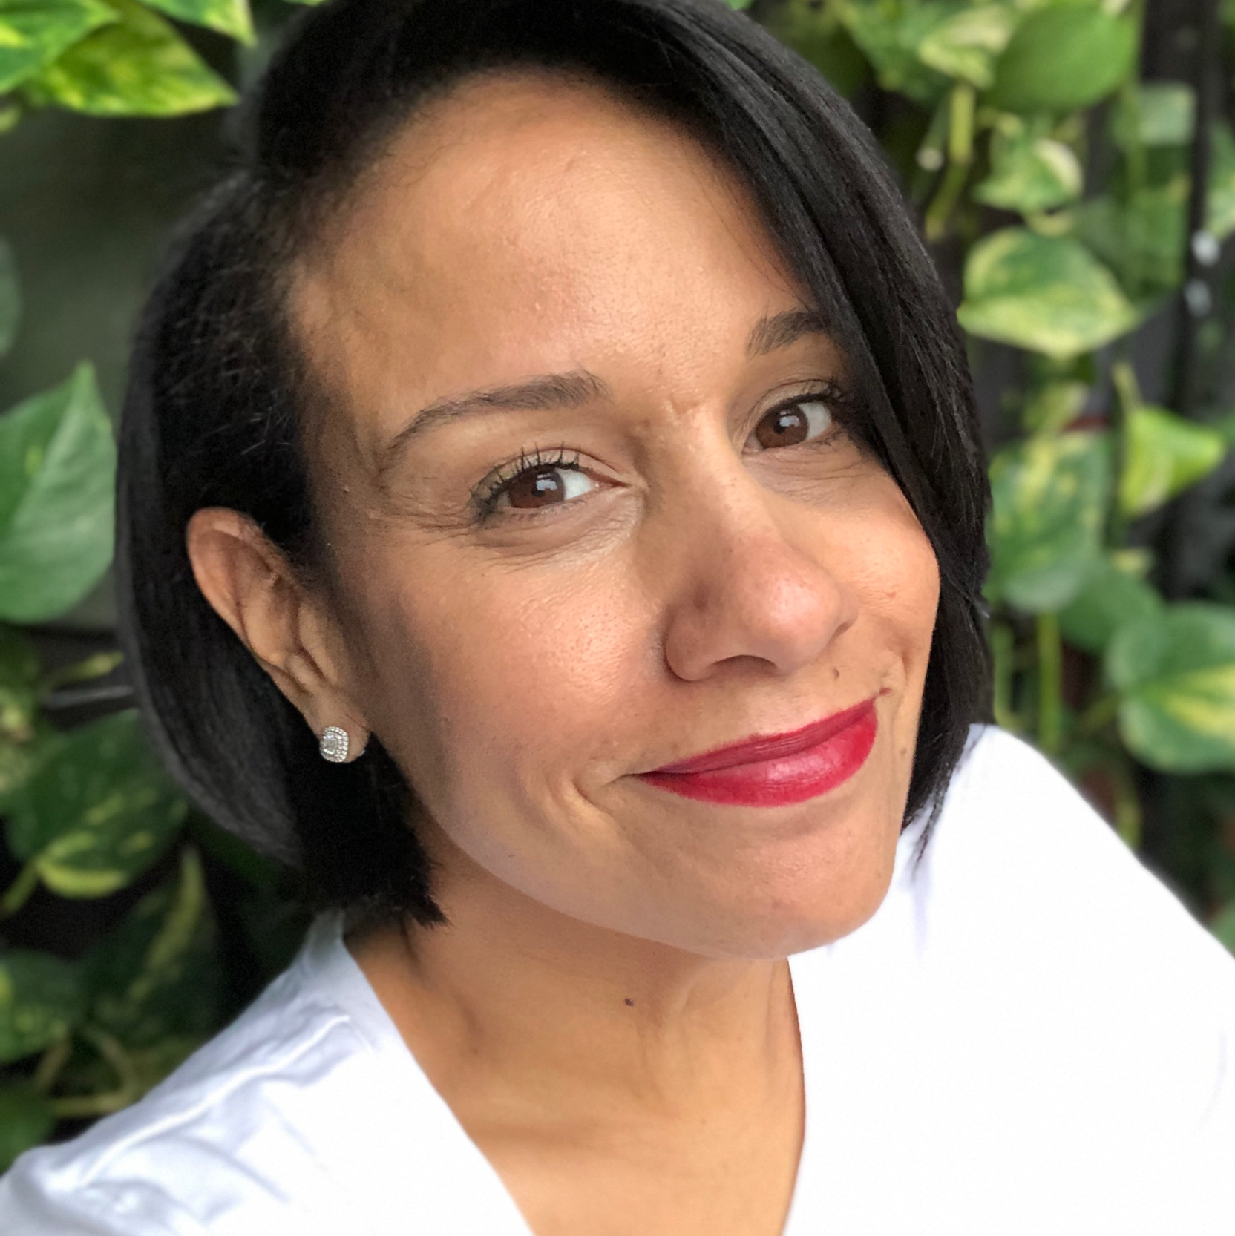
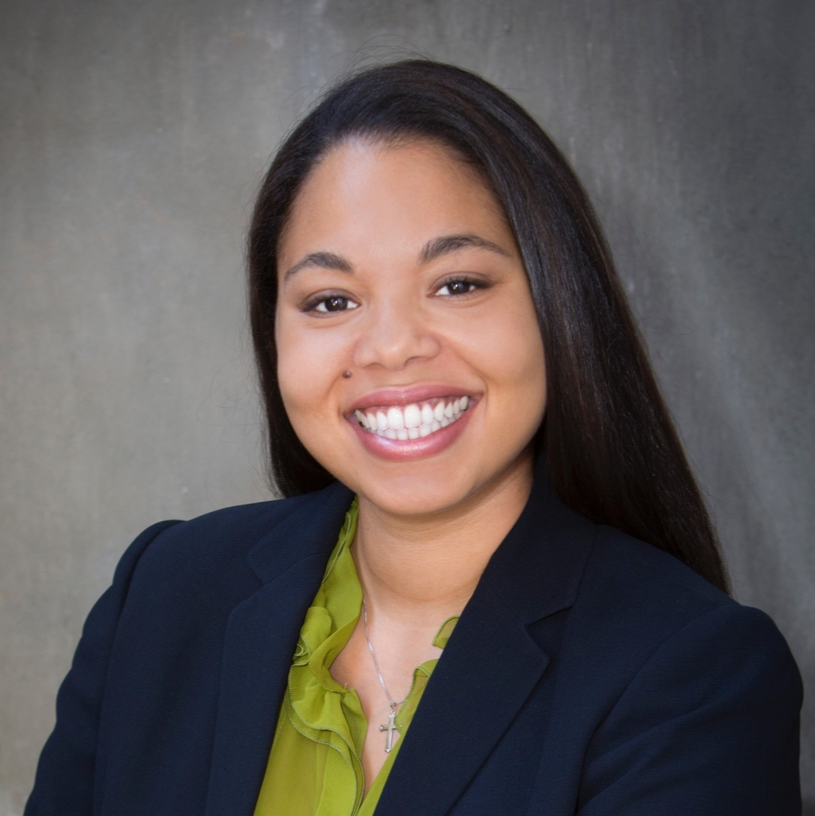
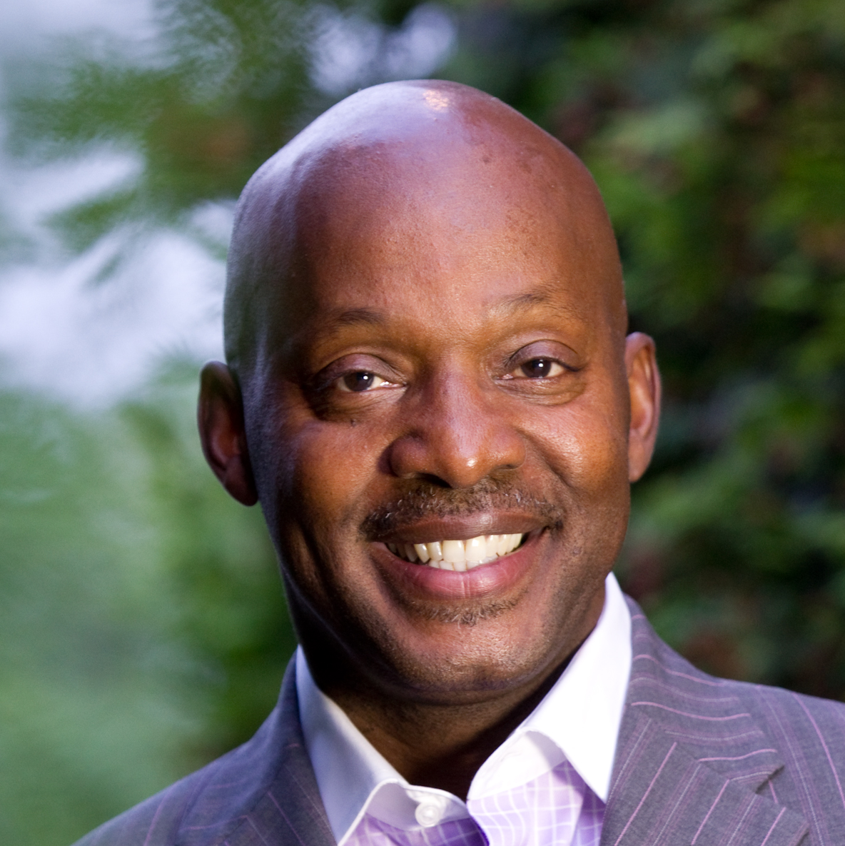






Community/Environmental and Social
Justice/Equity and Resiliency
Faustina Vincent
President
VGI Energy Solutions
Dana Redden
Founder
Solar Stewards
Van Vincent
CEO & President
VLV Development
Notes:
Purpose:
The purpose of this slide is to relay the SAM program’s overall goals. On the left side, we are summing up the totality of program goals into one concise sentence. On the right side, we want to support the summed goal with its relevant subgoals to provide context of how to get there.

