Slide 1
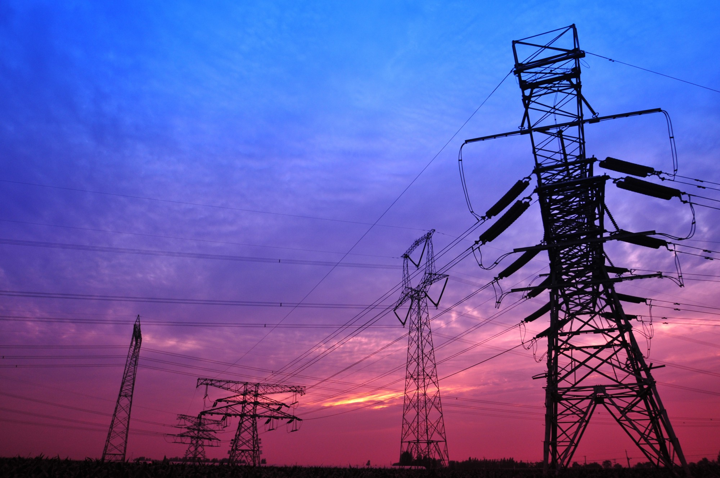
Our Team
Our Idea
Utilizing the space cleared for HV power lines to generate energy for rural communities.
Solar arrays would line HV corridors and be connected to battery systems to create microgrids for communities along those corridors.
Rural communities are underserved by the renewables revolution. We want to change that.
Dr. Robert Giusti-
Over thirty years of experience as a doctor caring for underserved communities.
Mr. Alexander Dabertin
Grew up in a rural community. Seven years of experience as an educator and communicator
JUICED COMMUNITY ENERGY

