Slide 1

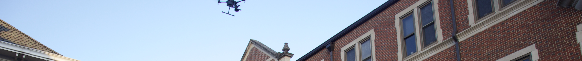
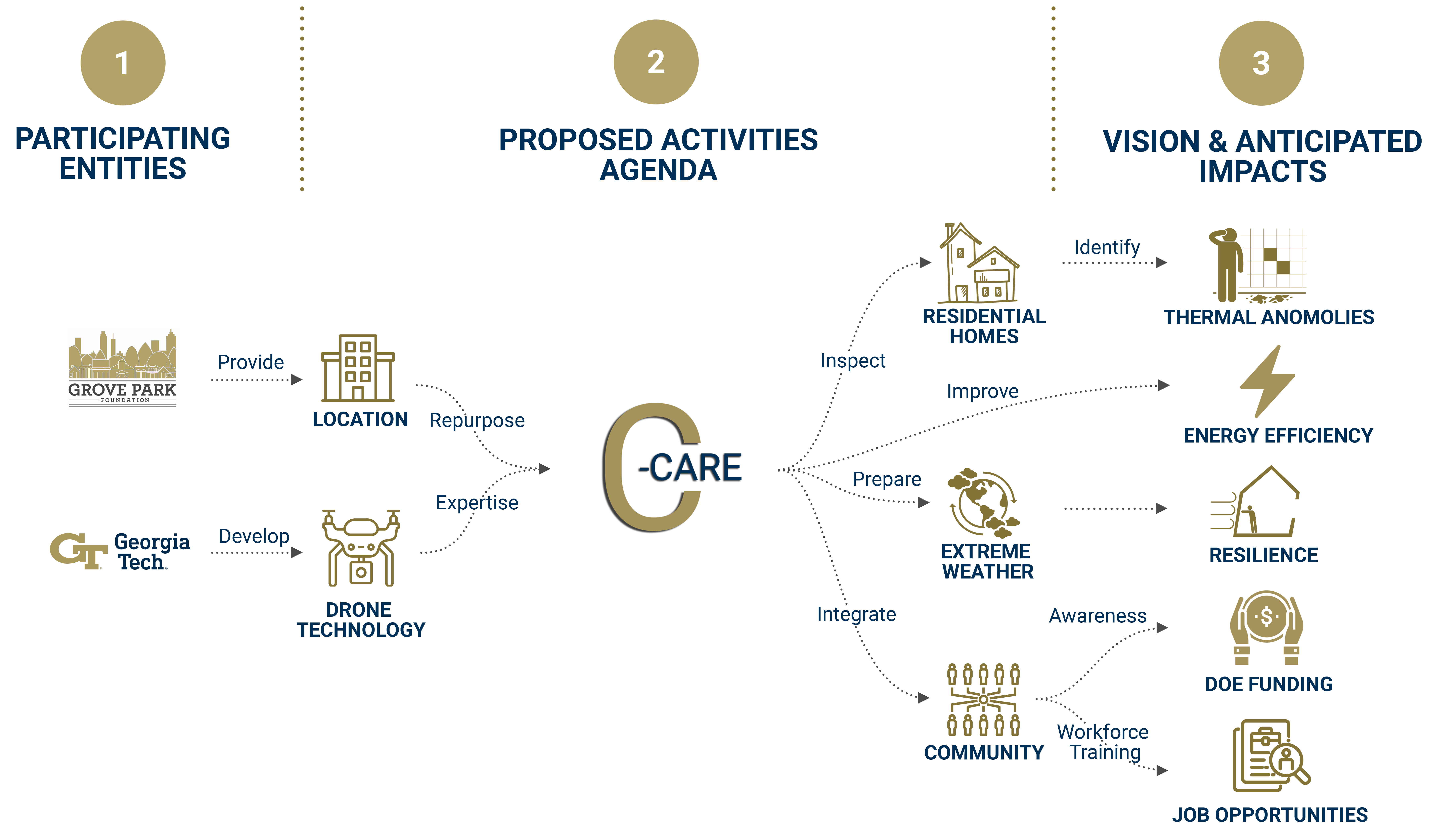
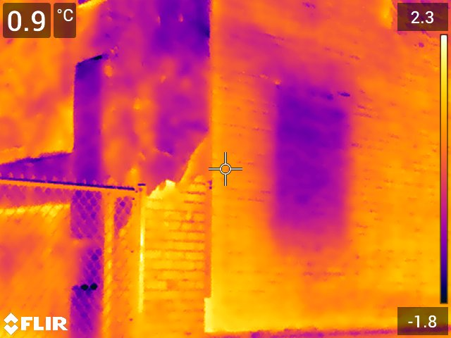
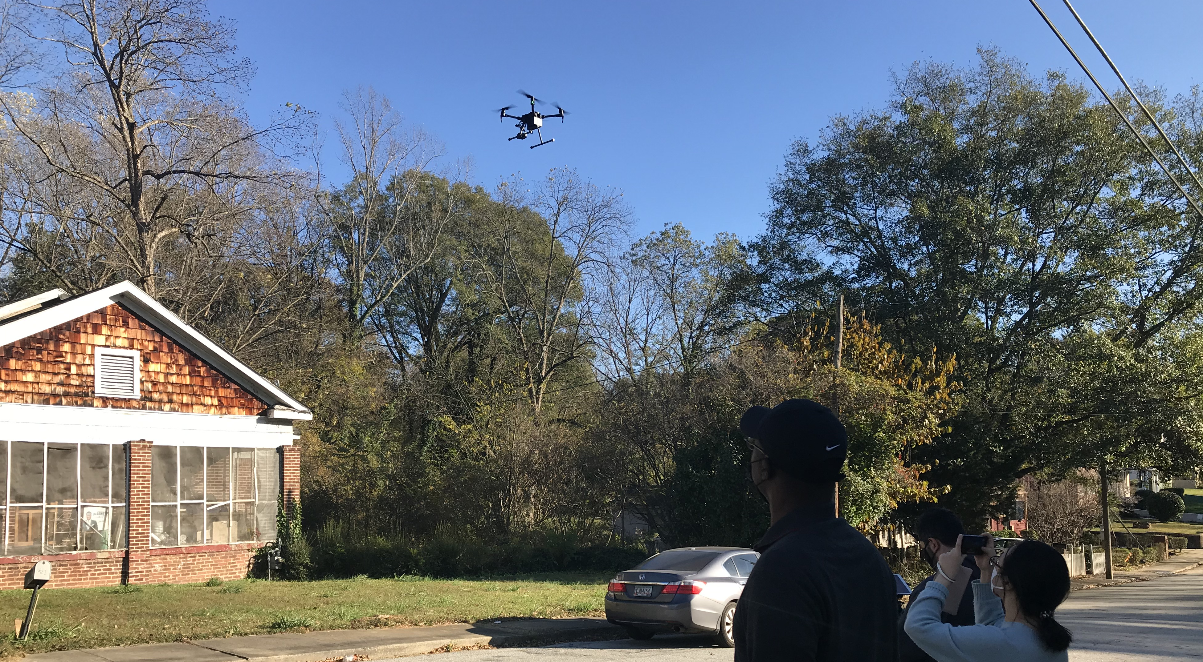
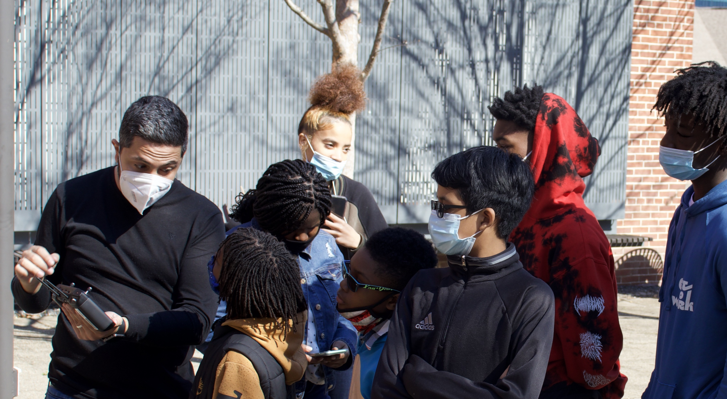
COMMUNITY CENTER FOR ADVANCED RESILIENCE EDUCATION
GEORGIA TECH AND THE GROVE PARK FOUNDATION, ATLANTA, GA
Inclusive Energy Innovation Prize
Georgia Tech has been collaborating with the Grove Park Neighborhood since 2019 to deploy diagnostic drone technology developed in the High Performance Building Lab (HPBL) to identify building exterior defects. We are developing a community center that employs this technology to inspire STEM careers, train the next generation of young professionals as aerial auditors, and create jobs for retrofitting buildings. The goal is to scale this type of collaboration for more US neighborhoods to be resilient against climate change.
Building Envelope Thermography
to Diagnose Thermal Anomalies
Fast, Cheap, Safe and Accurate
Drone-based Analytics
“
“
INCLUSIVE AERIAL DIAGNOSTICS TO RETROFIT AGAINST CLIMATE CHANGE
Educating Grade School Students on Technology

