Slide 1

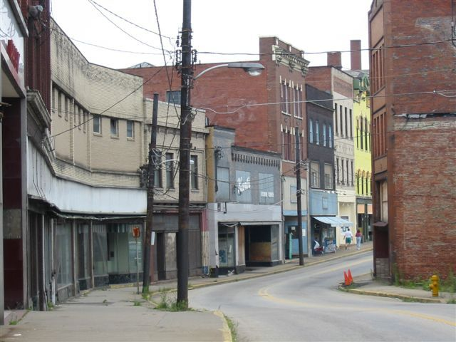
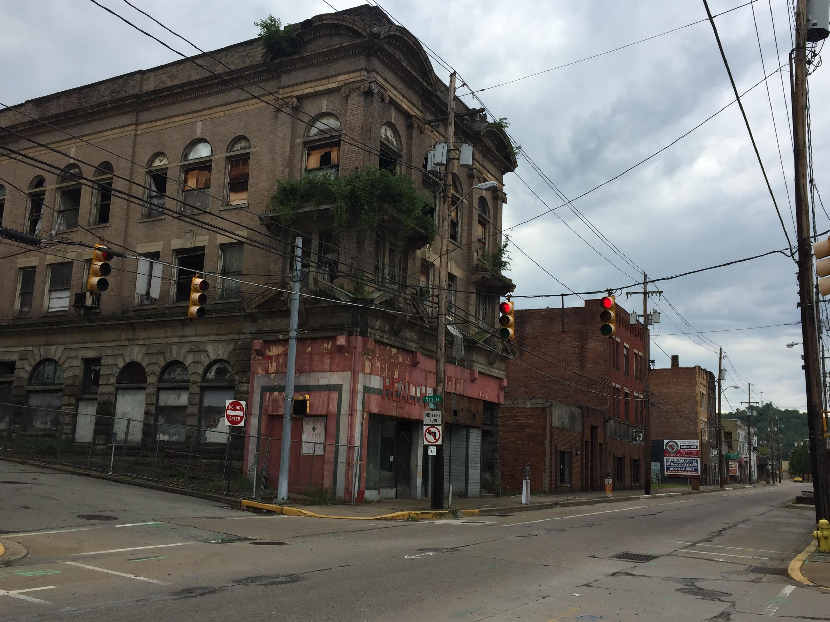

Mon Valley Solar Initiative
OUR TEAM
Mon Valley Alliance (MVA, a non-Profit dedicated to betterment of Mon Valley communities)
Exodus Renewables
Penn State University Extension
Pigeon Creek Sanitary Authority
THE PROBLEM
The Mon Valley has been an economically distressed region for decades
MVA would like to utilize non-buildable property to utilize clean energy to provide community benefits
PA has no solar incentives or community solar
Our non-profit cannot directly benefit from federal tax credit and deprecation incentives
There is no playbook for non-profits to participate in clean energy projects
OUR SOLUTION
1+ MW solar farm in Mon Valley; all benefits (low-cost energy, health, profits) flow down to economically disadvantaged communities
Non-profit forms partnerships with local companies to leverage tax incentives and finance solar farm
Solar farm provides low-cost energy to local sanitary authority and clean energy sourced EV charging
MVA partners with local education entities to utilize farm for training
MVA develops mechanisms to distribute solar farm profits to communities through community support programs

