Slide 1
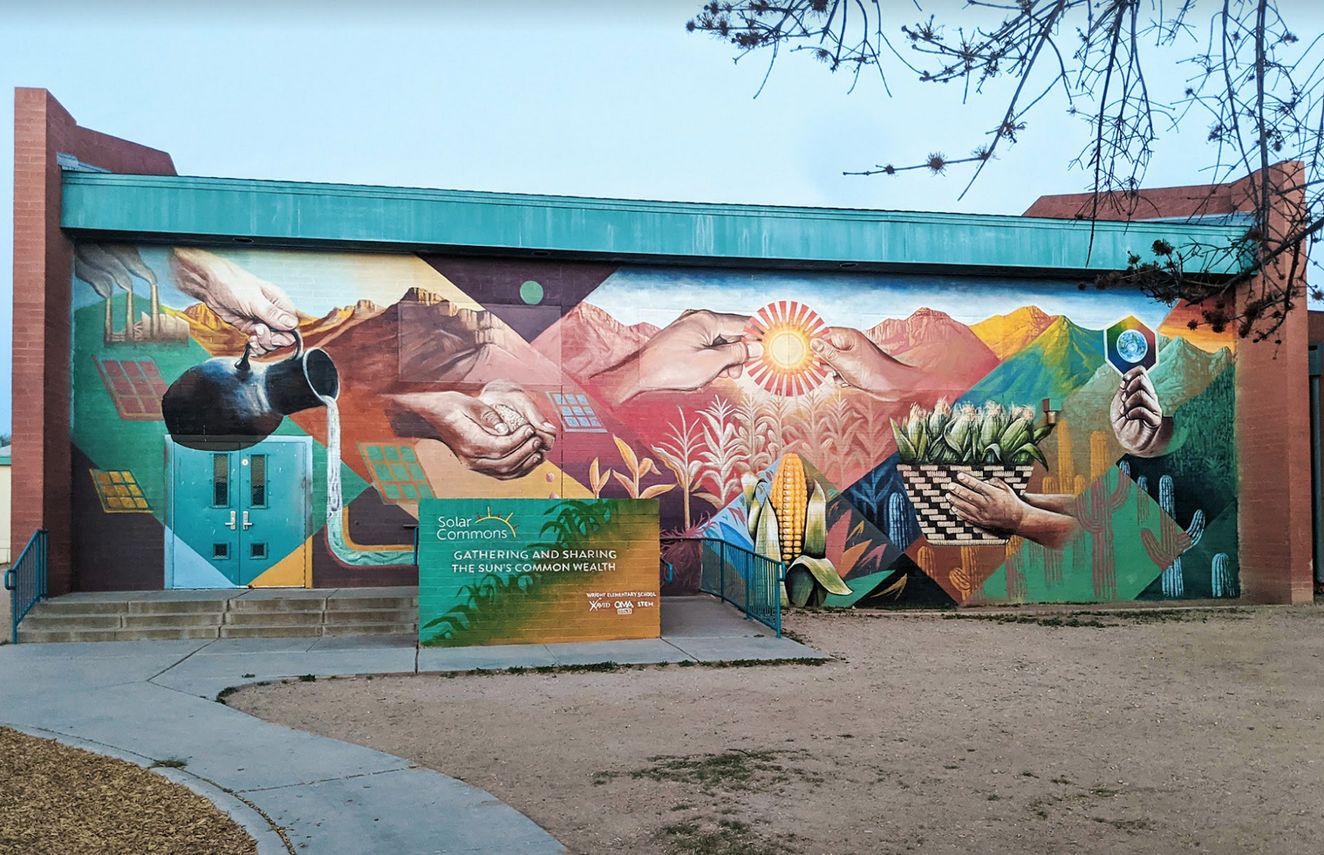
Solar Commons
Initiative
Solar Commons is a 501(c)(3) nonprofit research and development lab integrating common wealth into a just energy transition. We make the sun’s common wealth visible and useable through community trust ownership of PV solar savings, digital peer governance dashboards and public art. We work with researchers, low-wealth community partners and funders to co-create, pilot and make publicly available DIY tools and templates for the Solar Commons Trust Model. We have one (14.5kW) interconnected Solar Commons in Tucson, AZ and one (500kW) in development to benefit the Bois Forte Band of Chippewa in rural, northern MN. Solar Commons is a much-needed innovation of the commons sector. State sector agencies raise money for public good through taxes. Market sector actors raise funds for private industry through banks. But what institutions do civic groups, in particular historically disadvantaged civic groups, have to build long-term revenue streams for collective action in their communities? Solar Commons would be an institution in the commons sector. Civic groups engaged in “solar commoning” would have a tried-and-true way to fund reparative mutual aid work they undertake to help themselves help each other. Integrated into our 21st century energy transition, Solar Commons would reshape 20th century solar technologies into 21st century social-ecological technologies.

