Slide 1
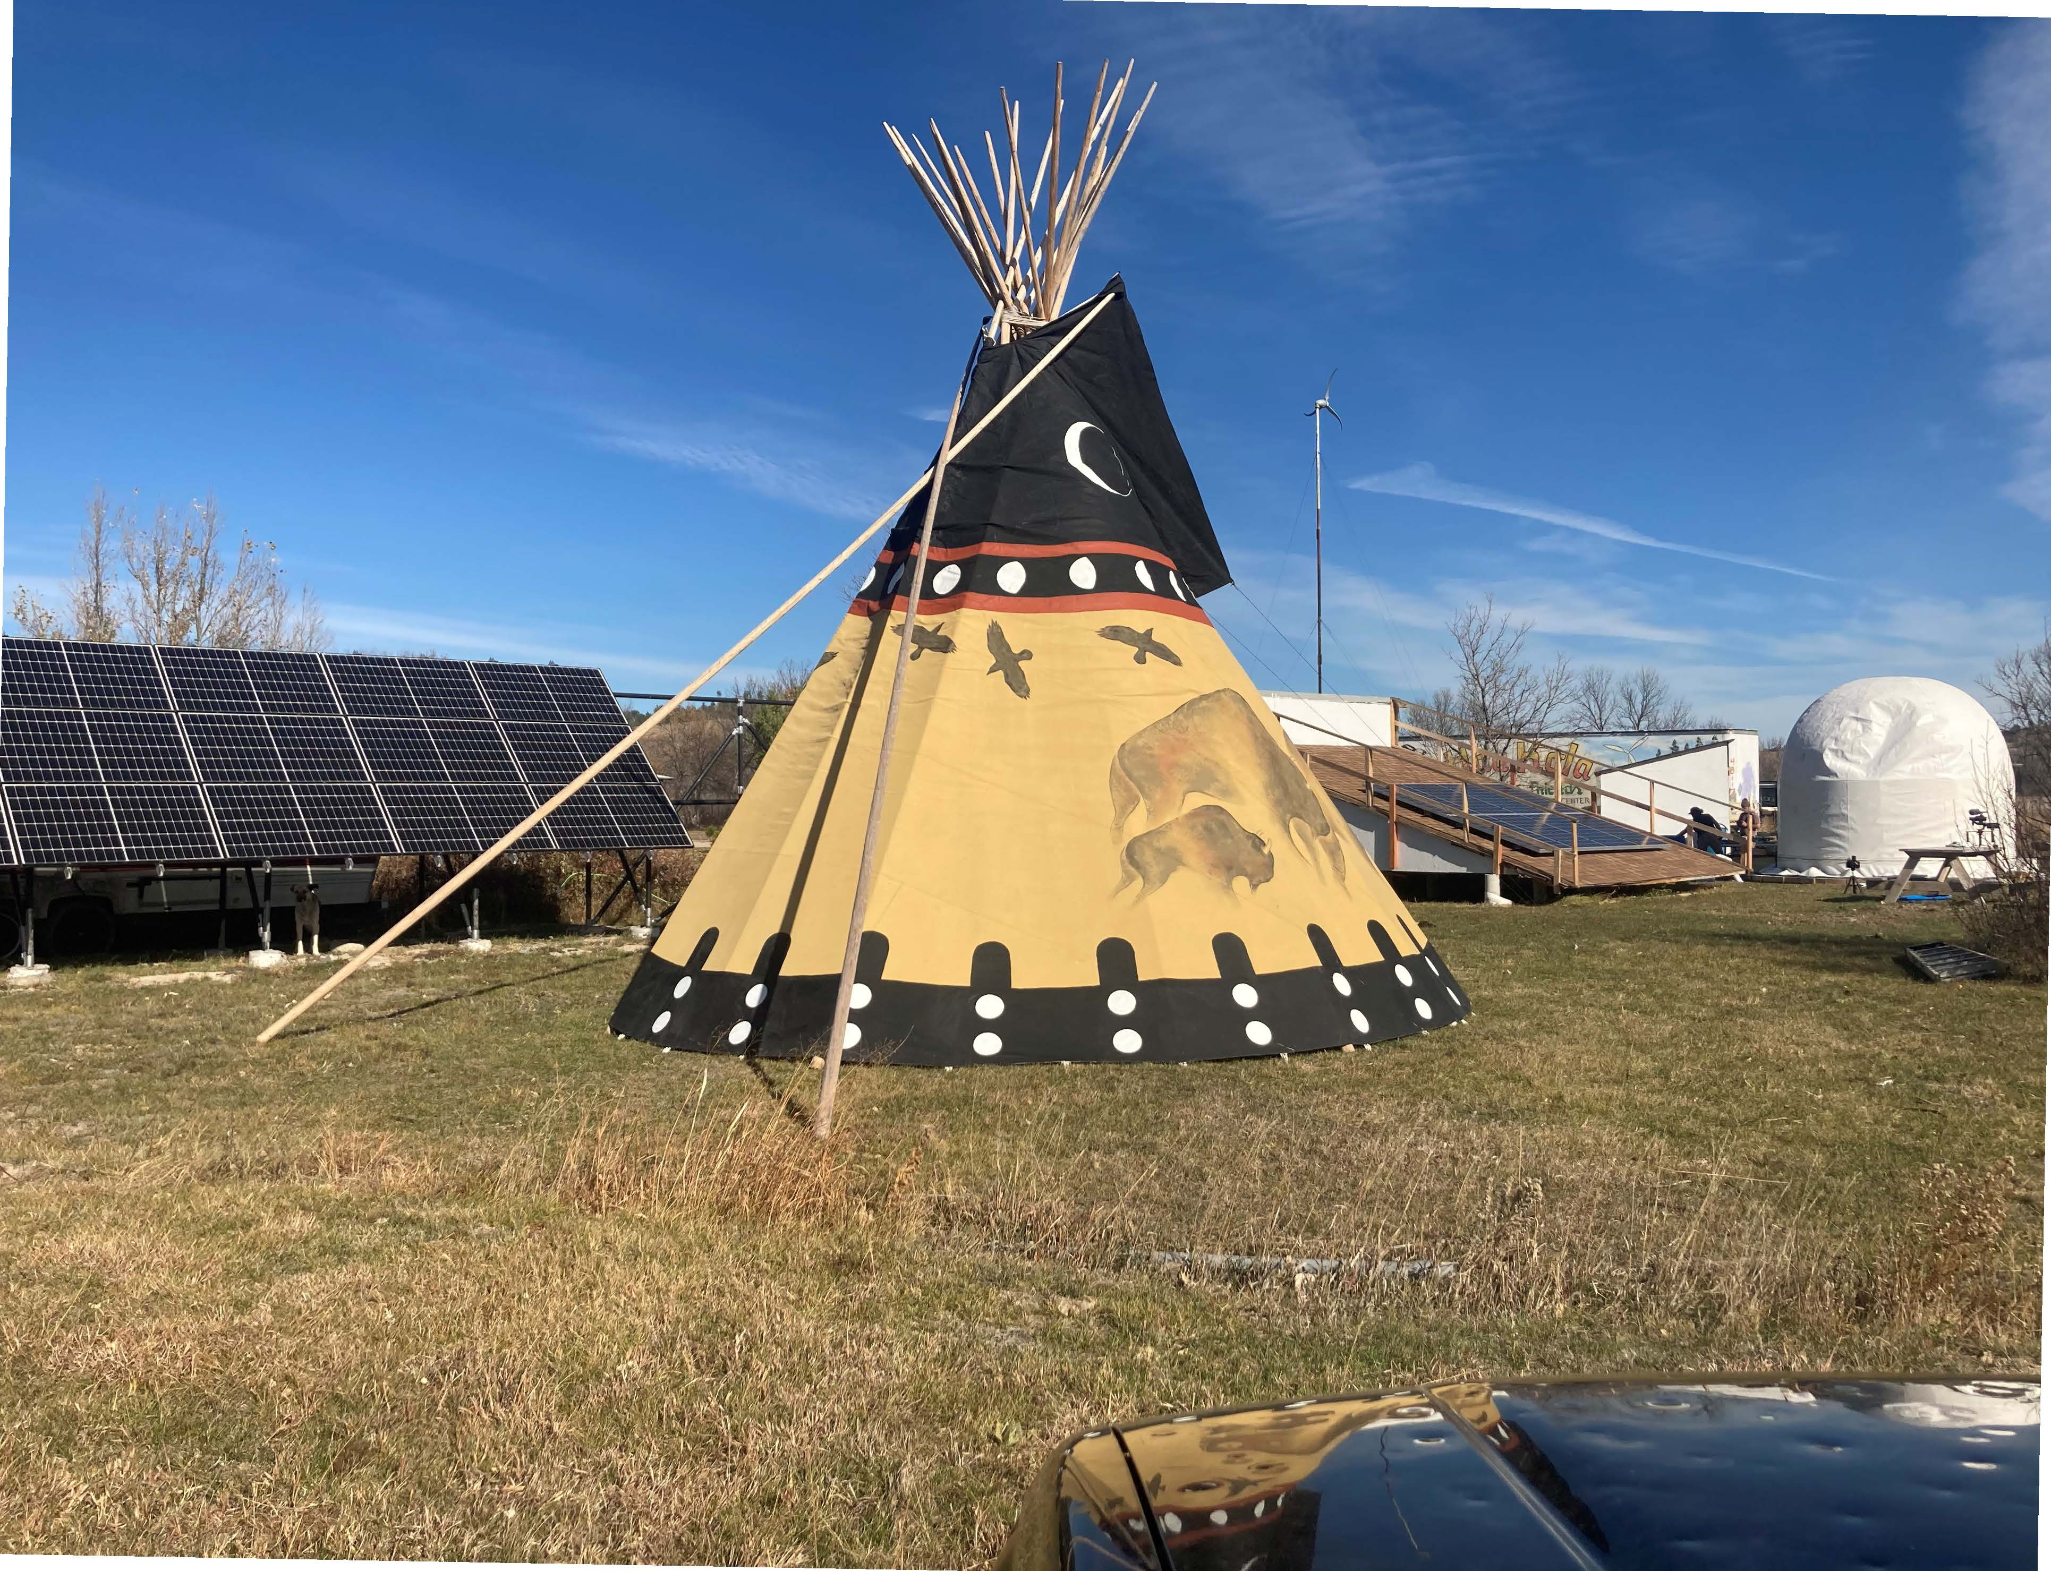
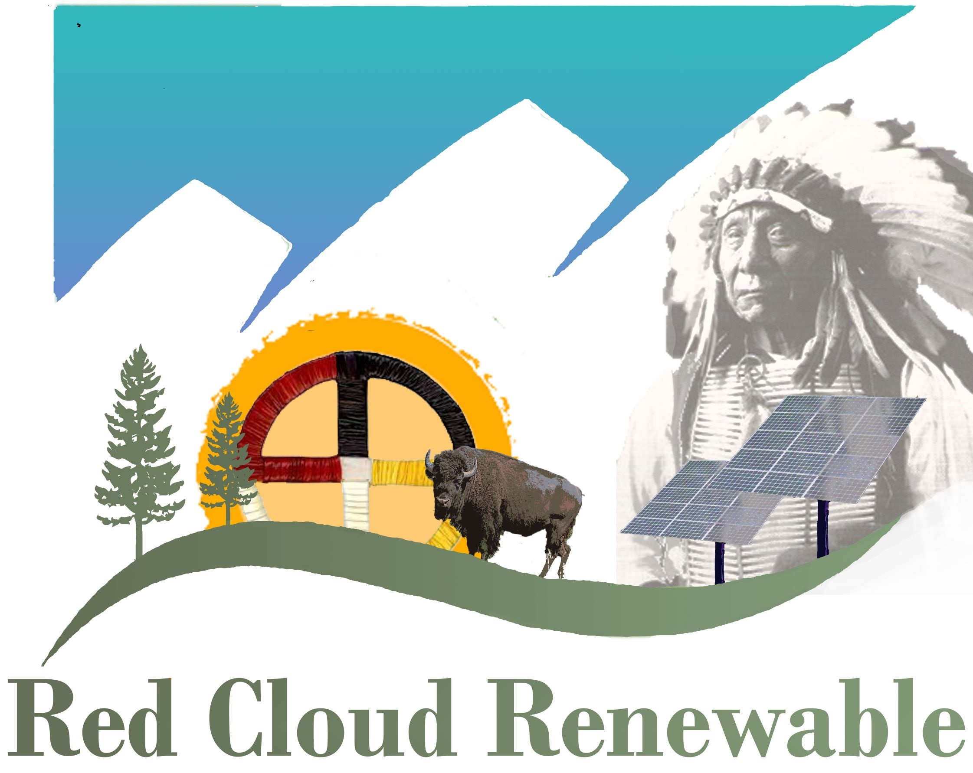
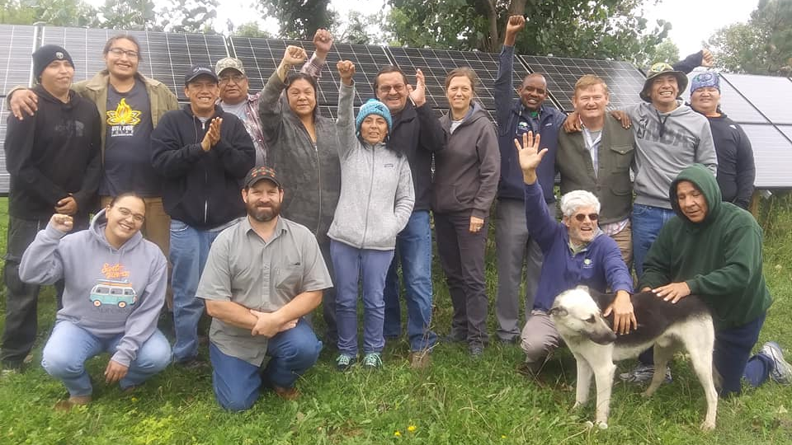
The Path to
Tribal Energy Sovereignty
Over the last nineteen years, we have worked with over 1,200 Native students from more than 70 tribes on developing renewable energy and sustainable living training and installation projects in disadvantaged tribal communities
Our mission is to stimulate a significant revisioning of tribal communities where energy is created in renewable ways, meals are nutritional and fortified by traditional Lakota foods, homes are built in a sustainable way with local tribal builders and materials and the land is cared for and regenerated with the next seven generations in mind
A New Way to Honor the Old Way
Lakota Solar Warriors

