Slide 1

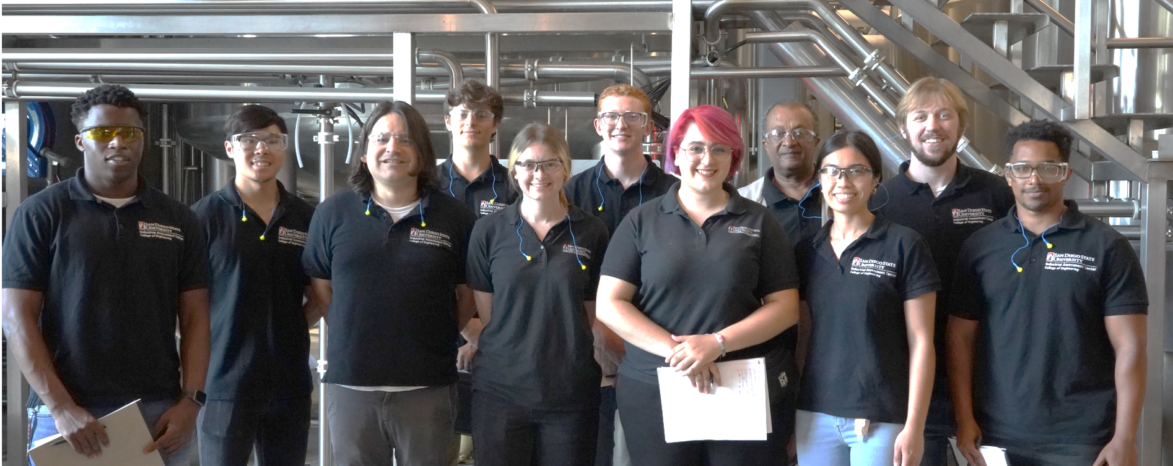
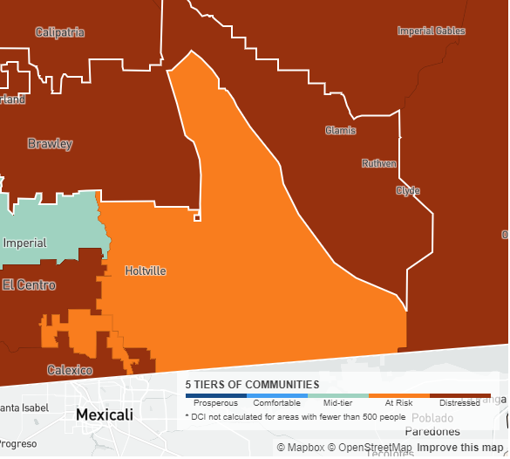
Building Energy Efficiency in Imperial Valley
San Diego State University – Imperial Valley Sustainable Energy Center
in collaboration with the Mechanical Engineering Department
Overall Objective
increase clean energy deployment in the Imperial Valley, an economically distressed region by offering no-cost, on-site consultations to assess energy infrastructure and potential for new clean energy deployment for 7 buildings in the region. Planned activities also include workforce and student training.
Clean Energy and Climate-Smart Goals Addressed
Imperial Valley, CA
distressed communities
building infrastructure
solar power
fuel cells
HVAC
lighting
controls, etc..
workforce training
building staff from disadvantaged communities
STEM opportunities for students from SDSU-IV, a Hispanic Serving Institution
increasing funding
potential for deployment
government funds
private funds
utility incentives
Expected Outcomes
equitable, grass-roots clean energy deployment in Imperial Valley buildings
energy consultation and workforce training for 7 Imperial Valley buildings
guidance on potential external funding sources for clean energy deployment
STEM and clean energy training for 2 SDSU – Imperial Valley students
prosperous
distressed

