Slide 1




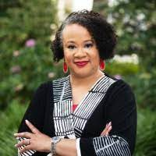
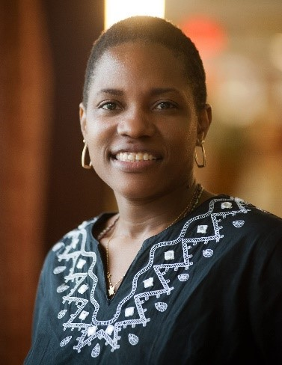

The Savannah GREEN Network
Six-organization coalition with a vision for Green, Resilient, Equitable, and Empowered Neighborhoods.
Partnership between the City of Savannah Office of Sustainability, the Economic Opportunity Authority of South Georgia, Step Up Savannah, the Harambee House, and two locally-tied community engagement consultants.
The purpose of our partnership is to empower frontline communities in Savannah to realize their visions for the clean energy transition
We propose to achieve this goal through the creation of a resident internship and fellowship program that is designed to address three identified deficiencies in community capacity
  Lack of routine engagement between grant applicants and frontline communities
  Lack of human resources in Savannah to support clean energy/EJ work
  Lack of capacity in existing organizations to support additional projects/grant applications

