Slide 1
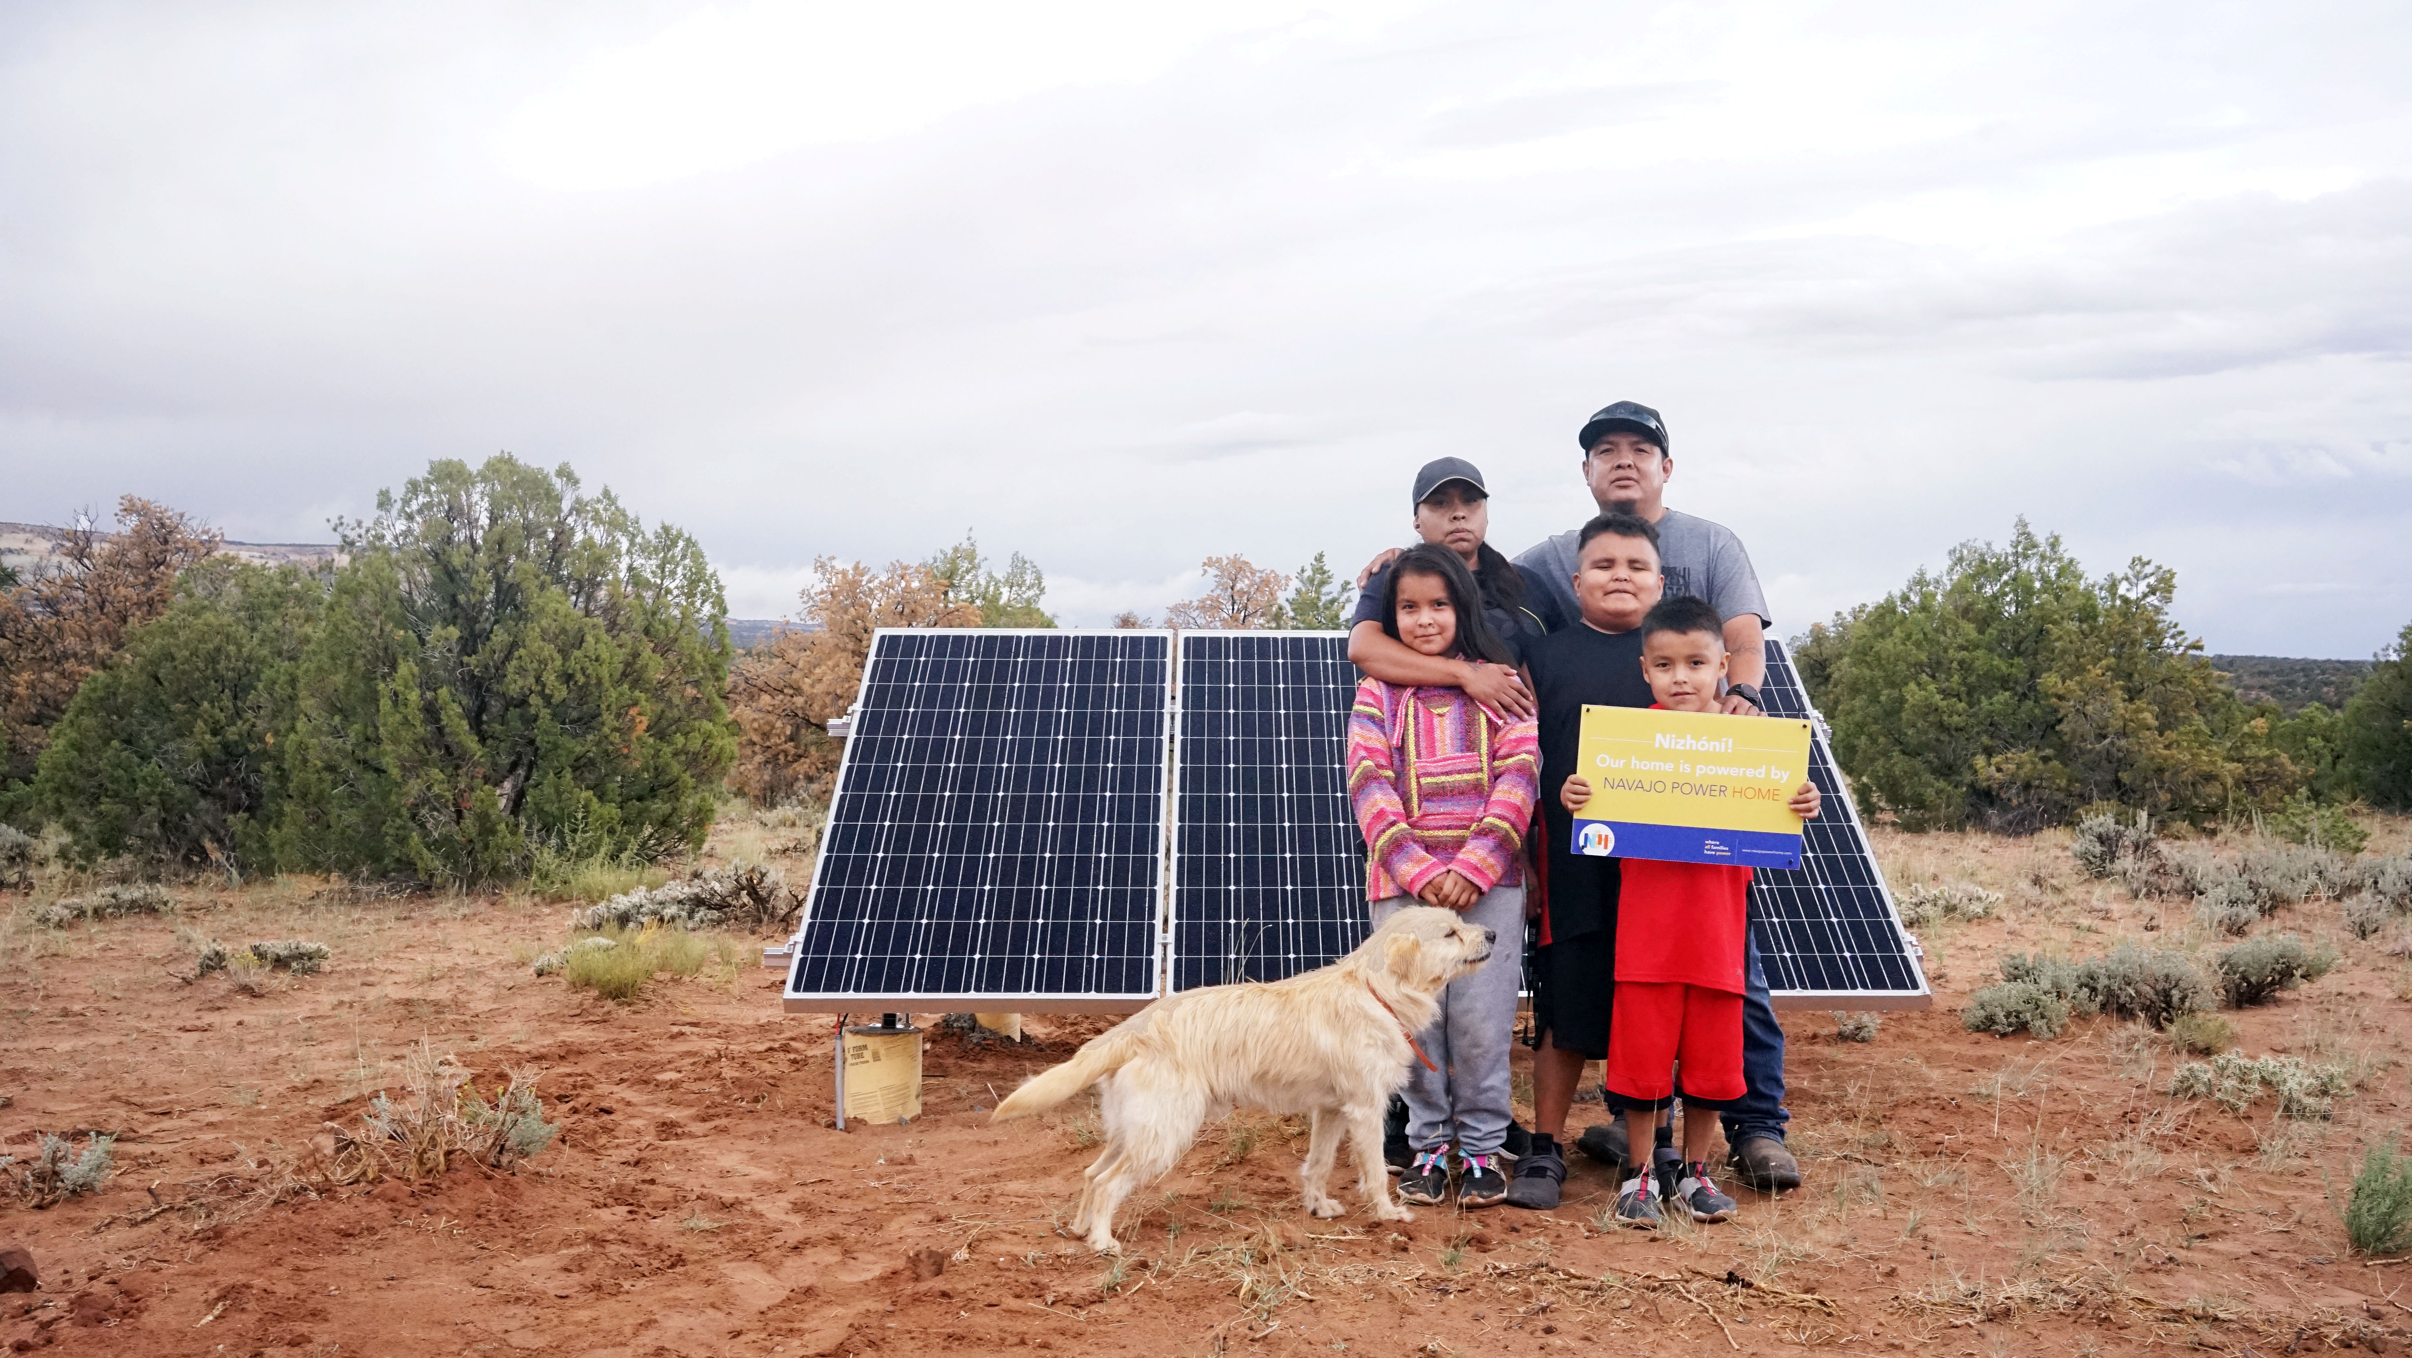
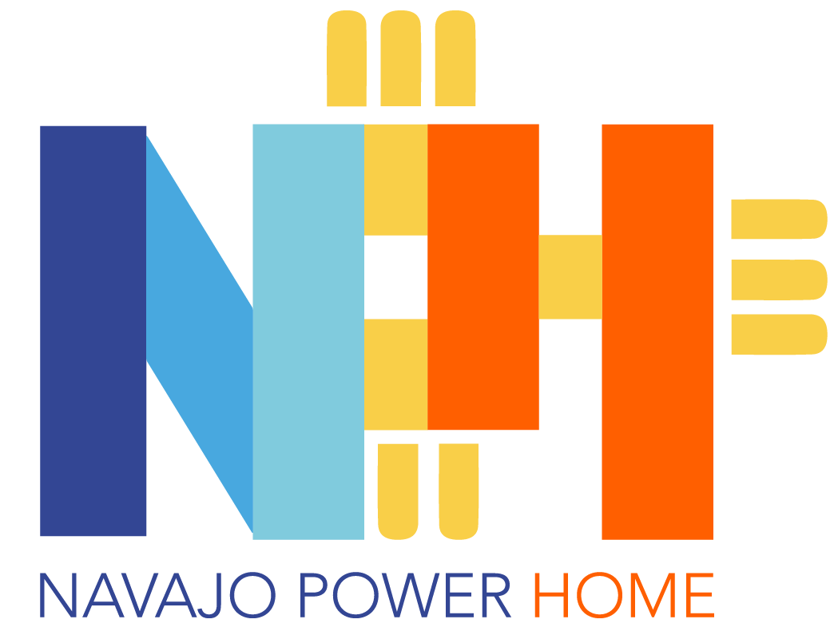
Solar-as-a-Service for off-grid Navajo Homes
NPHome is a solar-as-a-service provider delivering off-grid power to homes on the Navajo Nation. During its launch in 2022, NPHome will install its solar service in 200 Navajo homes, bringing them high-quality, permanent, hassle-free electricity access.
www.navajopowerhome.com | where all families have power

