Slide 1

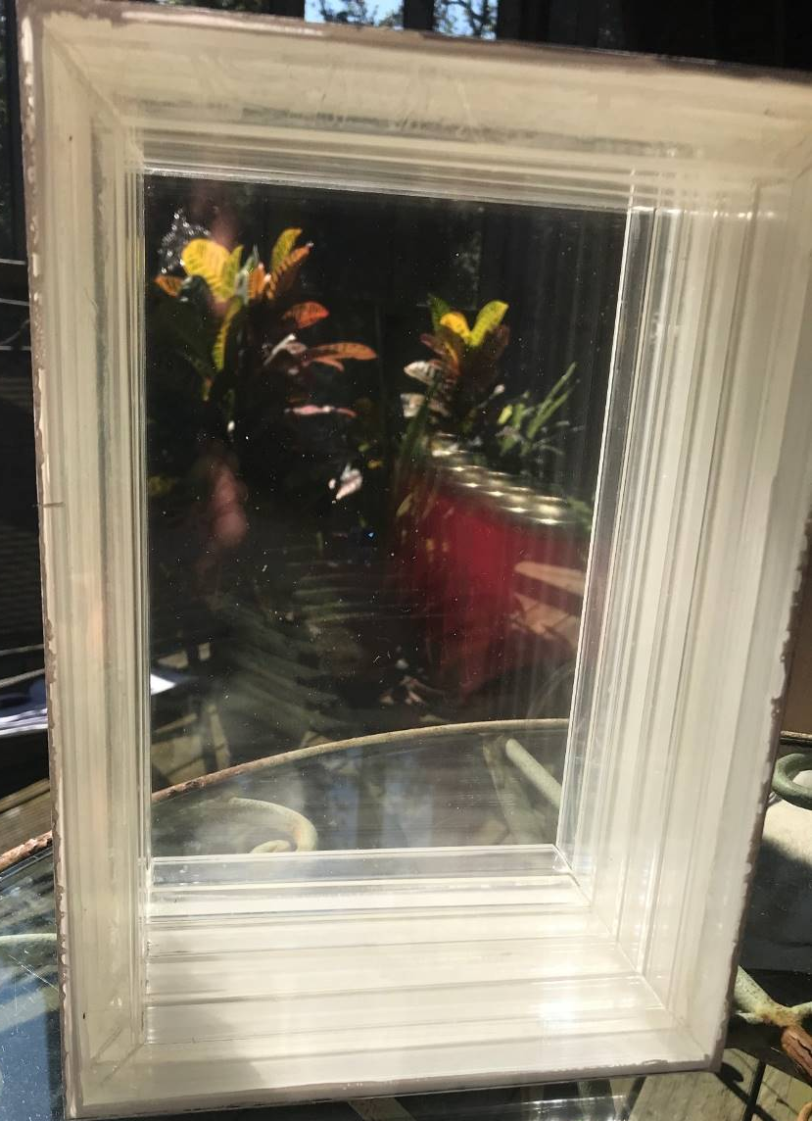
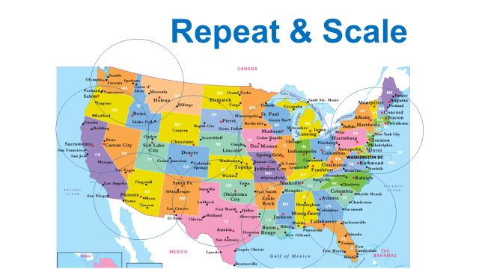
300-400%
Improved Energy-Efficiency at NO ADDED COST
WonderWindow
Makers Workshop
Year 10 projections:
$1 Billion Revenues
1 Million Net Zero Energy Buildings
10,000 Living Wage Makers with Lifted Life Outcomes per Year
$20/hour Living Wages
paid to Makers

