Slide 1
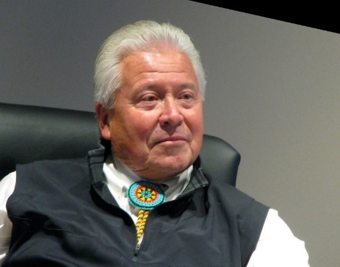
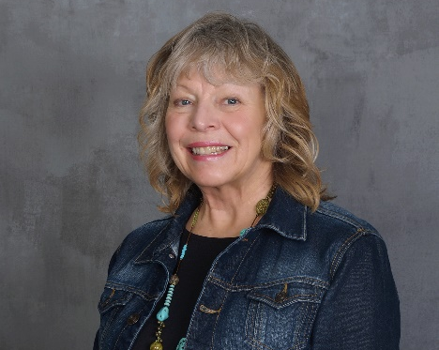

Greenlaw Homes
White Earth Net-Zero Sustainable Community
Greenlaw Homes, LLC is an Indian/Woman owned construction firm located on the White Earth Indian Reservation in Northern MN. The Company specializes in the design/build of net-zero residential and commercial buildings. The Company focuses on using sustainable construction materials and renewable energy systems to zero out all energy costs.
Our goal is to create the framework to build a sustainable community in each of the five villages on the White Earth Indian Reservation. Each will consist of 39 net-zero ready homes, 8 community buildings (derived from ten “grassroots engagement workshops”) powered by a 1MW community solar array with a microgrid and smart battery to zero out all energy costs for the sustainable community.
Eugene “Bugger” McArthur
Natalie McArthur
Nathan Greenlaw

