Slide 1

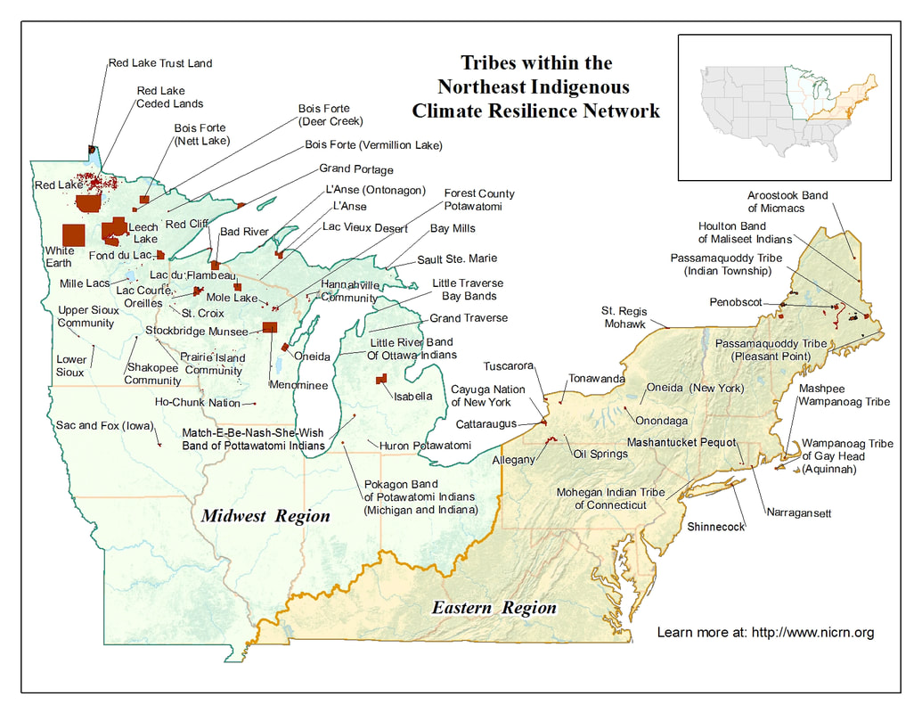





Ignite, Innovate, Indigenous (I3) Energy Team
Homes
Government
Businesses
Current Electric Utility Type
Investor-Owned
Municipal
Rural Cooperative
Tribal Renewable Energy Utility

